Slide 1
Introduction to Computing for Data Analysis
Does my (numerical) program compute the right answer?
Richard Vuduc, Ph.D.
Associate Professor
School of Computational Science and Engineering
Computing a sum, part 2: Life with floating-point
Notes:
Well, if it isn’t you again. Good to see you.
Now that you understand the analysis in the *exact* case, I want you to analyze what happens in the presence of floating-point rounding errors.

Slide 2
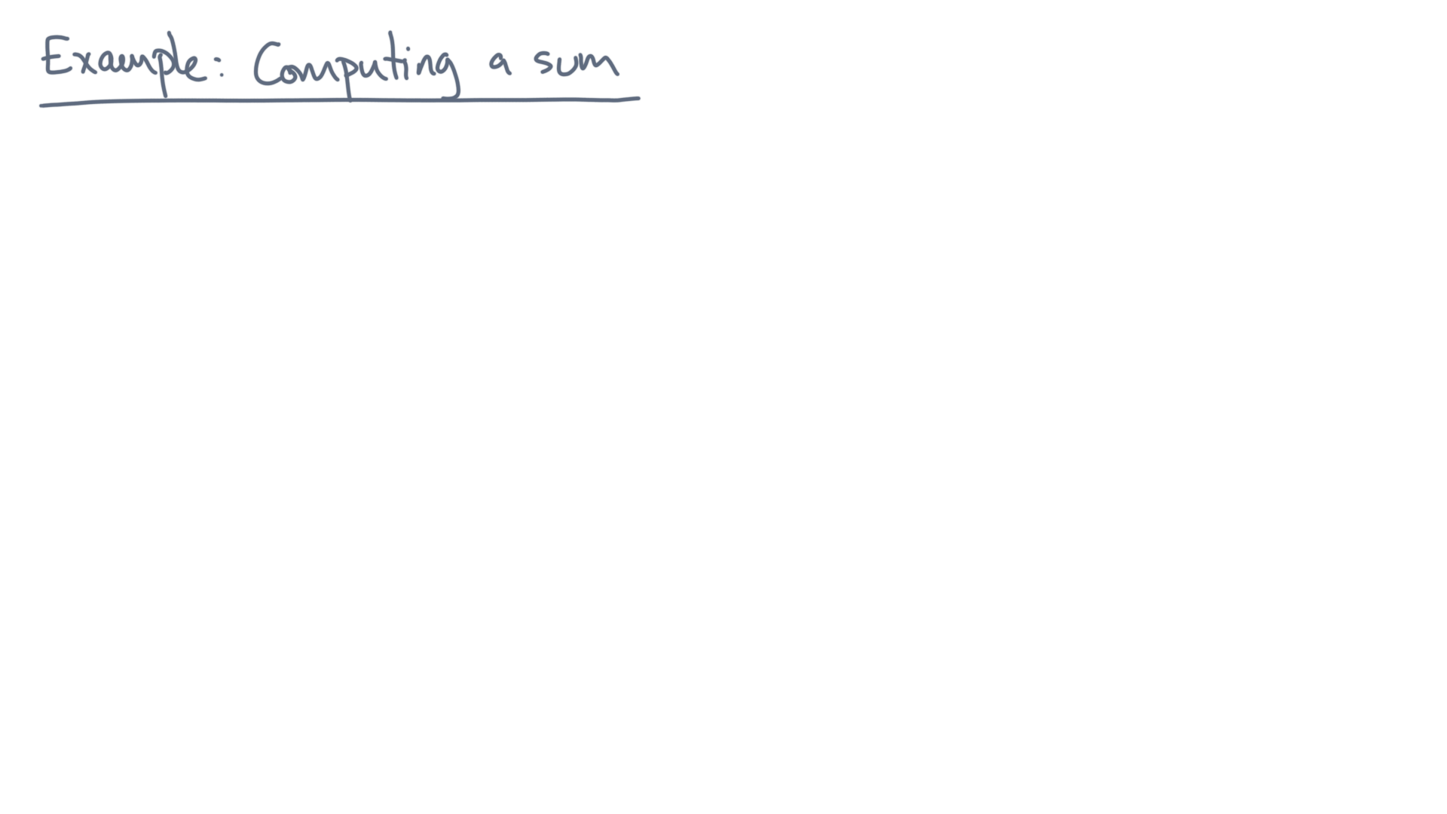
Notes:
Recall the formal problem.

Slide 3
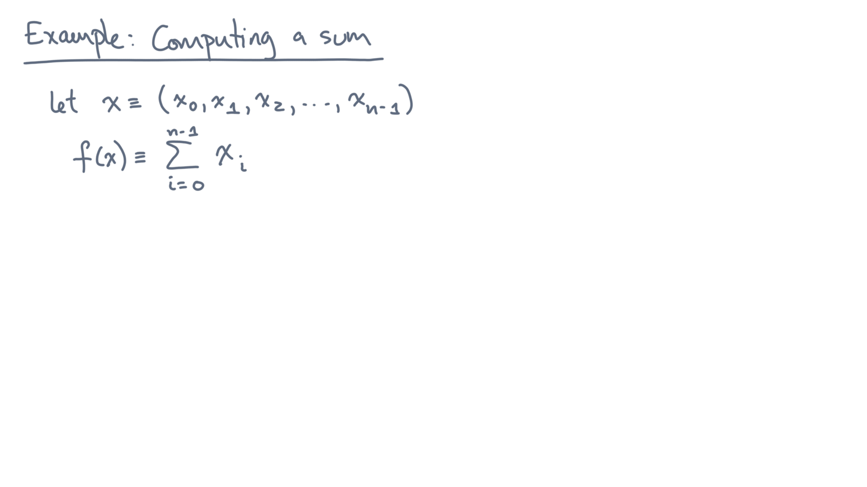
Notes:
Given a collection x of values values labeled x-zero through x-n-minus-one, you want to compute their sum.

Slide 4
def alg_sum(x):
s = 0.0
for x_i in x:
s += x_i
return s
Notes:
Here is your algorithm again, written as Python code.
In the previous lesson, you showed this code correctly computes the sum in exact arithmetic.

Slide 5
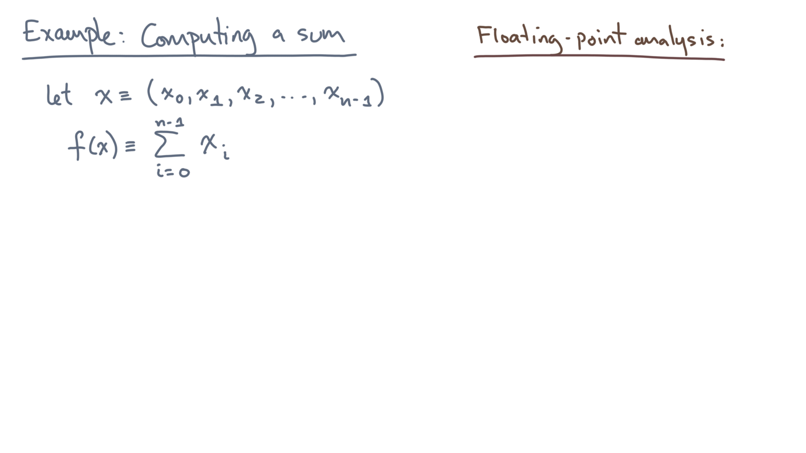
def alg_sum(x):
s = 0.0
for x_i in x:
s += x_i
return s
Notes:
Now what happens in true floating-point?

Slide 6
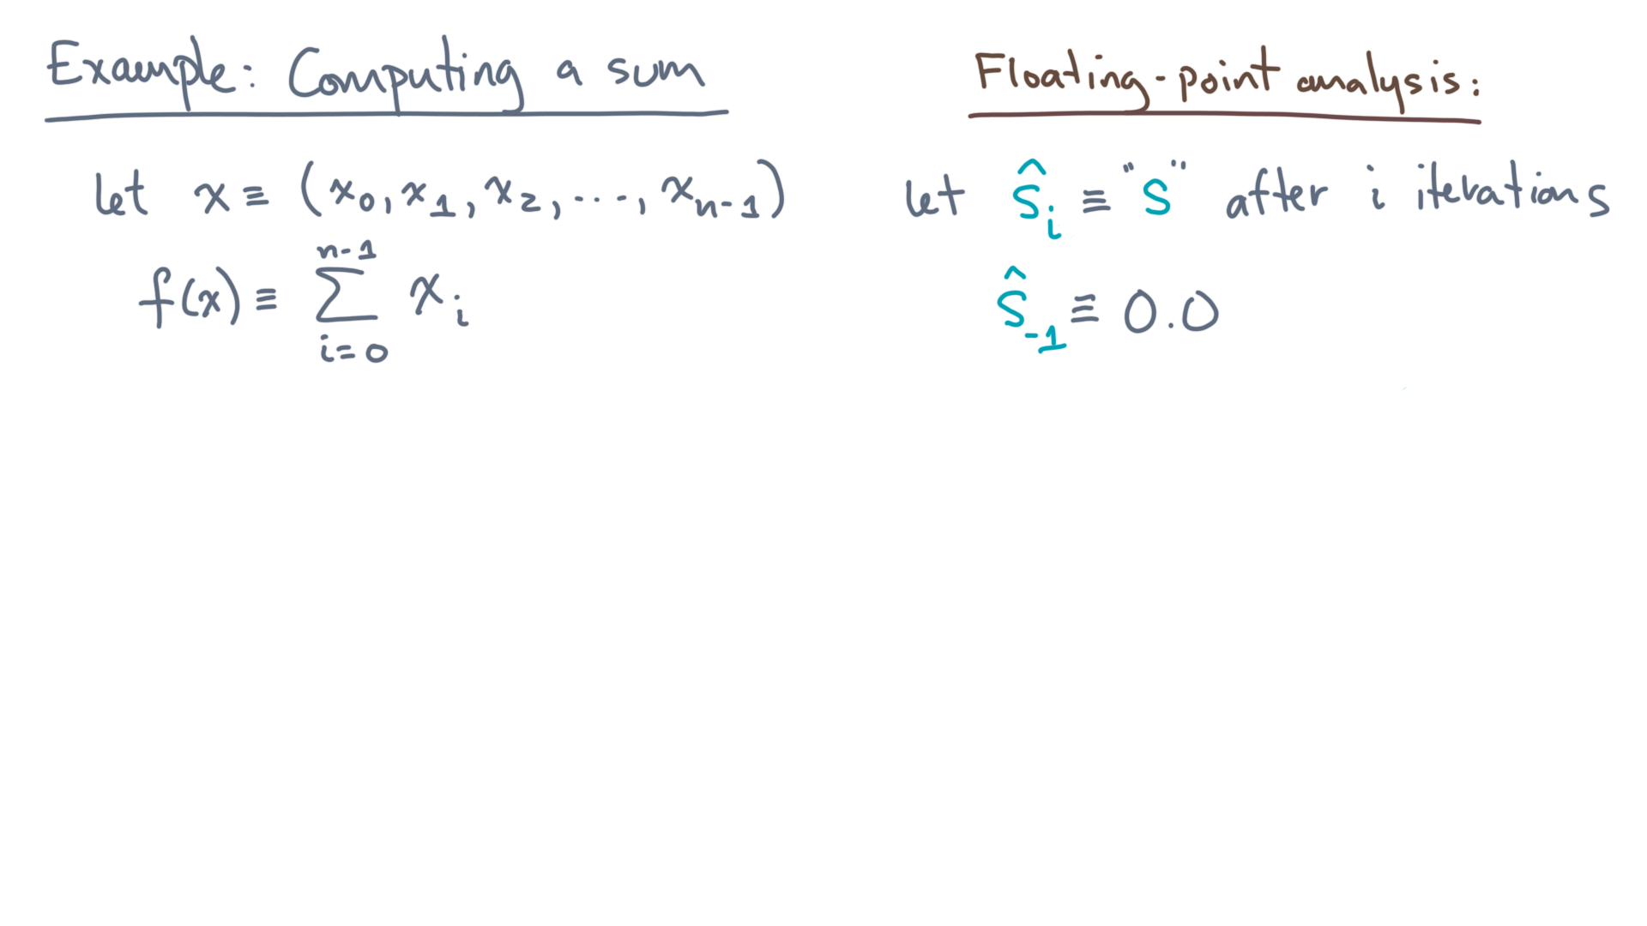
def alg_sum(x):
s = 0.0
for x_i in x:
s += x_i
return s
Notes:
Let s-hat-sub-i denote the value of “s” immediately after accumulating x-sub-i.

Slide 7
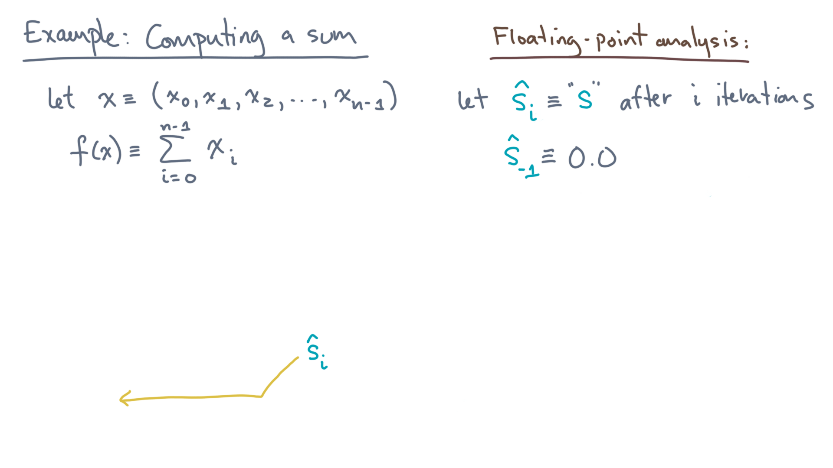
def alg_sum(x):
s = 0.0
for x_i in x:
s += x_i
return s
Notes:
That’s this point in the program.
And, as before, let s-hat-sub-minus-one equal the initial value, which is a floating-point zero.

Slide 8
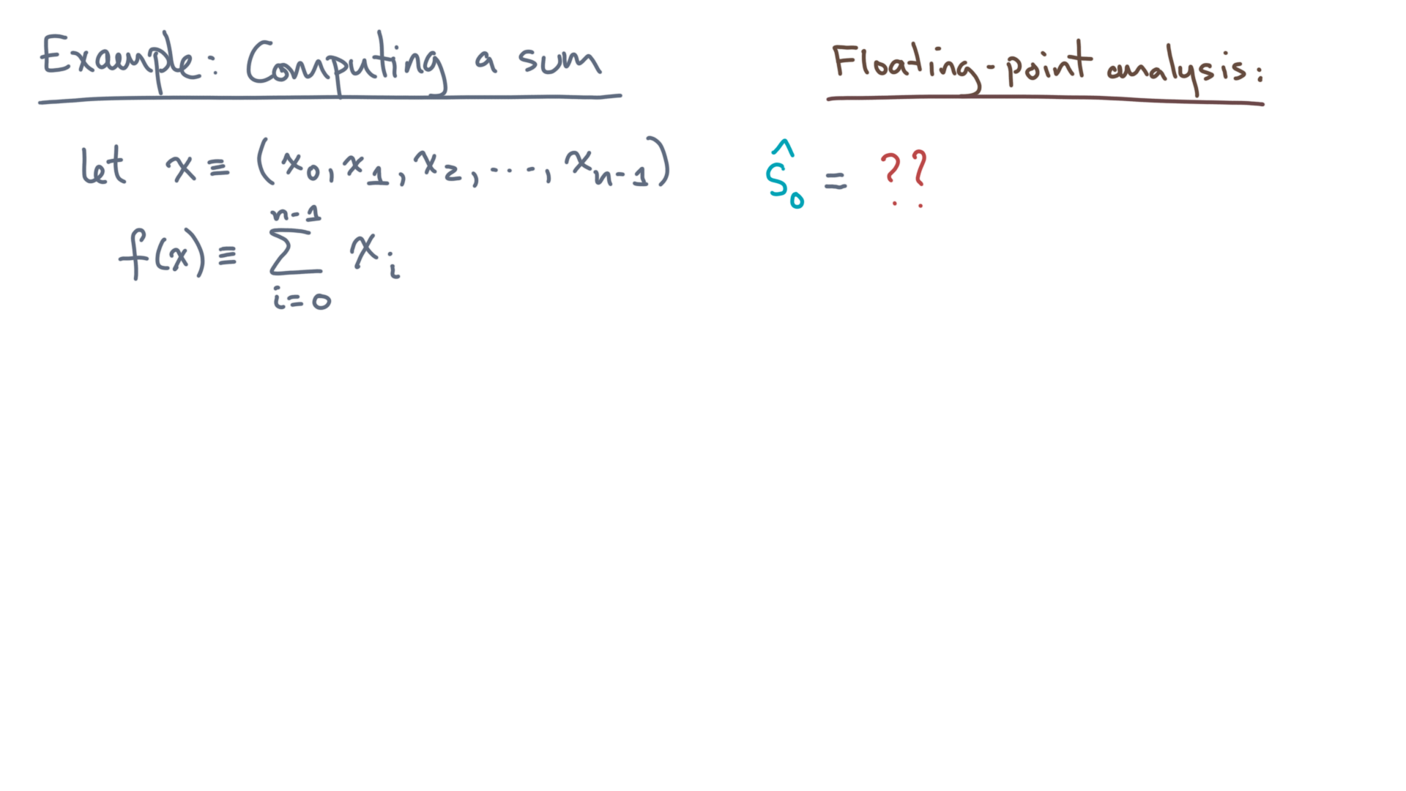
def alg_sum(x):
s = 0.0
for x_i in x:
s += x_i
return s
Notes:
Start by computing the first value, s-hat-sub-zero.

Slide 9
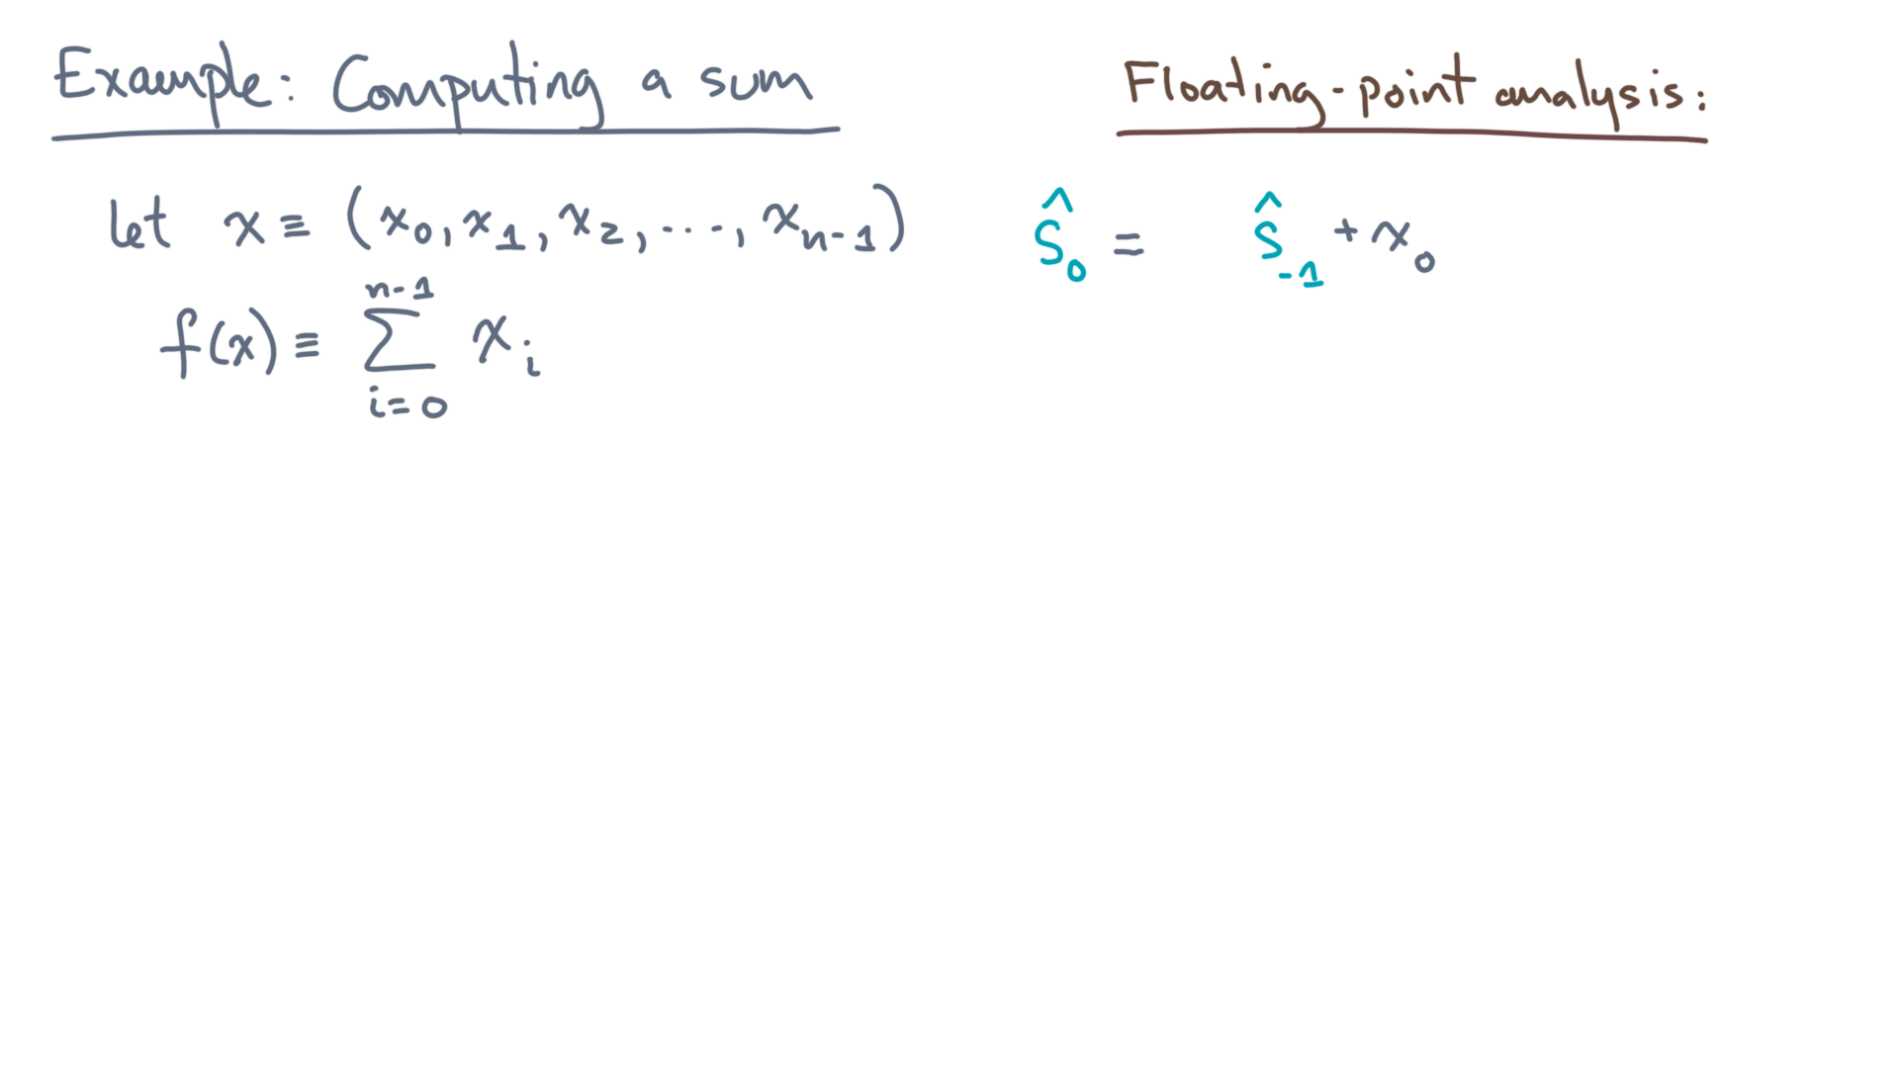
def alg_sum(x):
s = 0.0
for x_i in x:
s += x_i
return s
Notes:
It’s the previous, initial, value, plus the first element, x-sub-zero.
But remember, this is floating-point arithmetic!

Slide 10
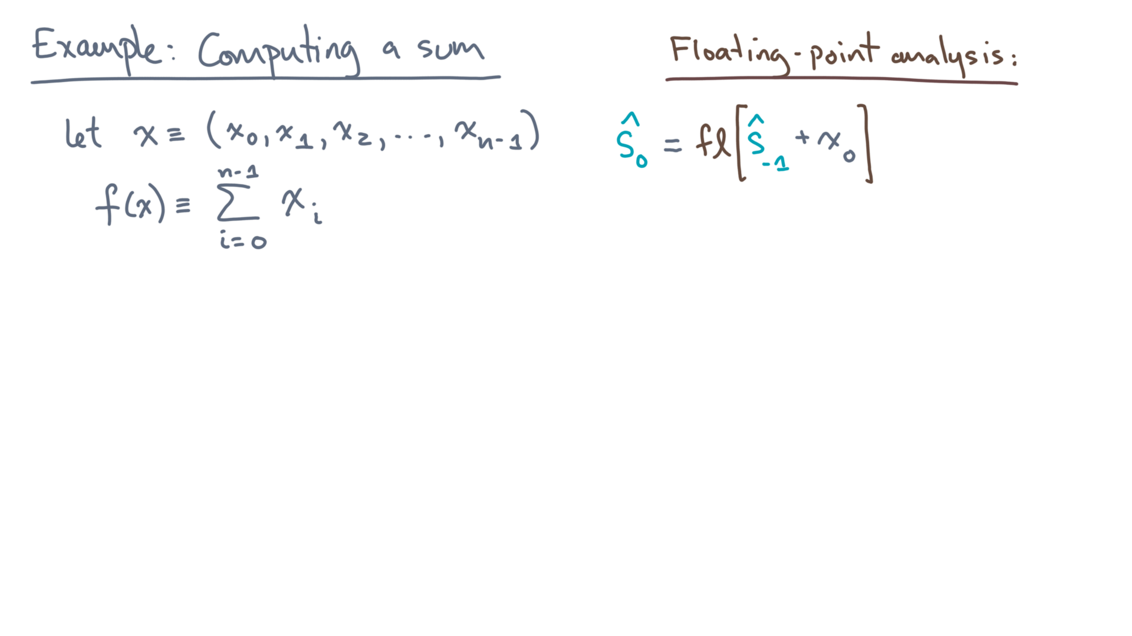
def alg_sum(x):
s = 0.0
for x_i in x:
s += x_i
return s
Notes:
Therefore, the value of s-hat-sub-zero is, in fact, a *rounded* version of this expression!
Now, recall our model of floating-point errors.

Slide 11
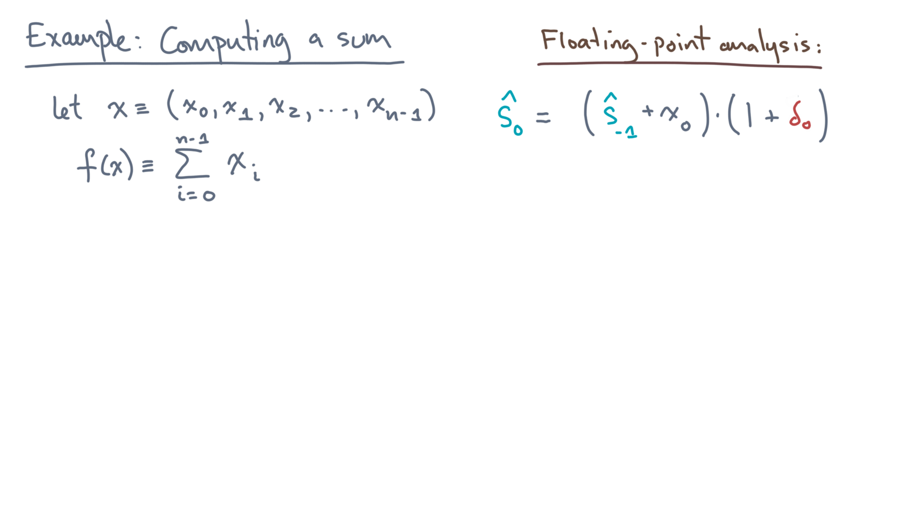
def alg_sum(x):
s = 0.0
for x_i in x:
s += x_i
return s
Notes:
The computed value is the true value times one plus some error.

Slide 12
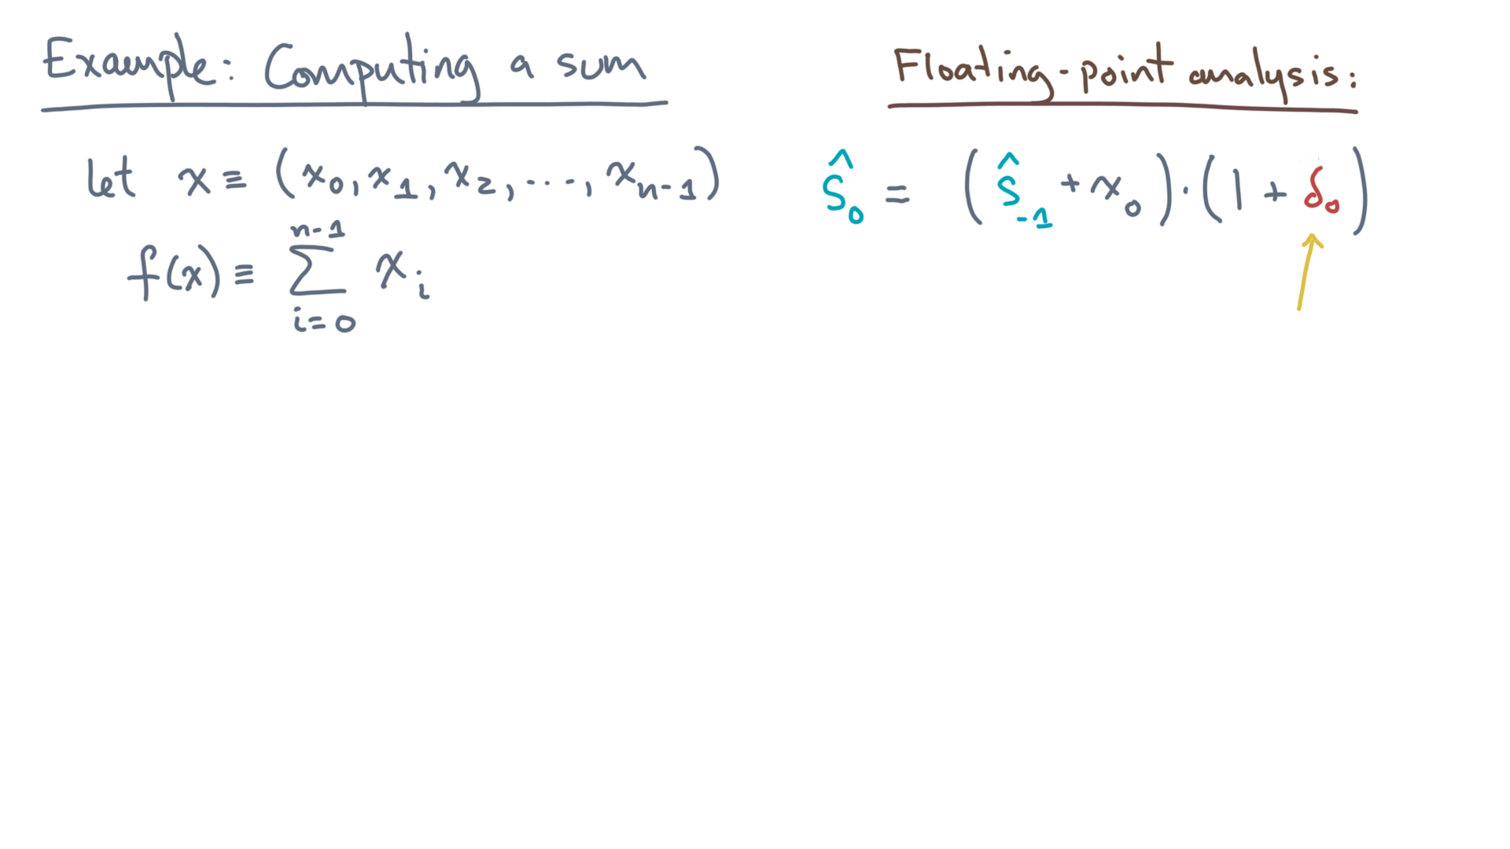
def alg_sum(x):
s = 0.0
for x_i in x:
s += x_i
return s
Notes:
Let’s call that error “delta-zero,” since it is the value of the rounding error associated with s-hat-zero.

Slide 13
def alg_sum(x):
s = 0.0
for x_i in x:
s += x_i
return s
Notes:
Now you can simplify the right-hand side a lot.

Slide 14
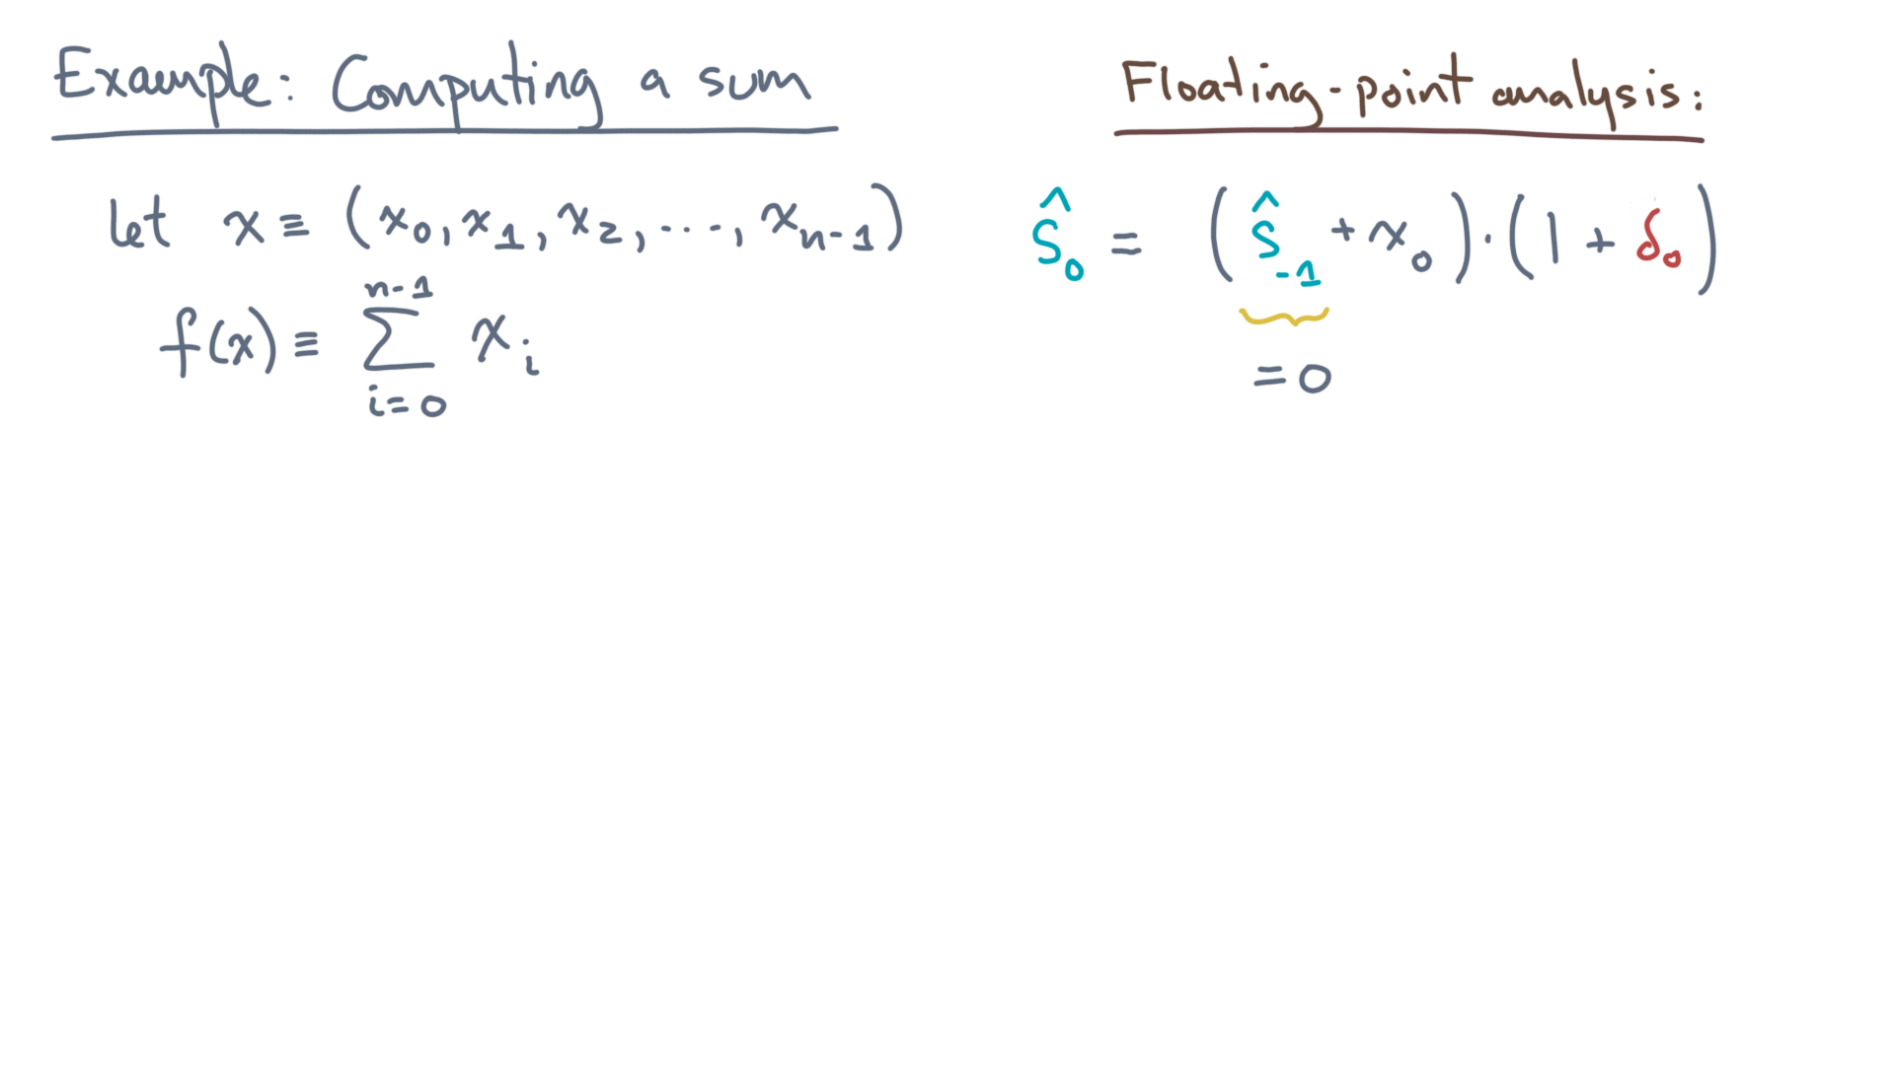
def alg_sum(x):
s = 0.0
for x_i in x:
s += x_i
return s
Notes:
First, recall that the initial value of “s” is zero.

Slide 15
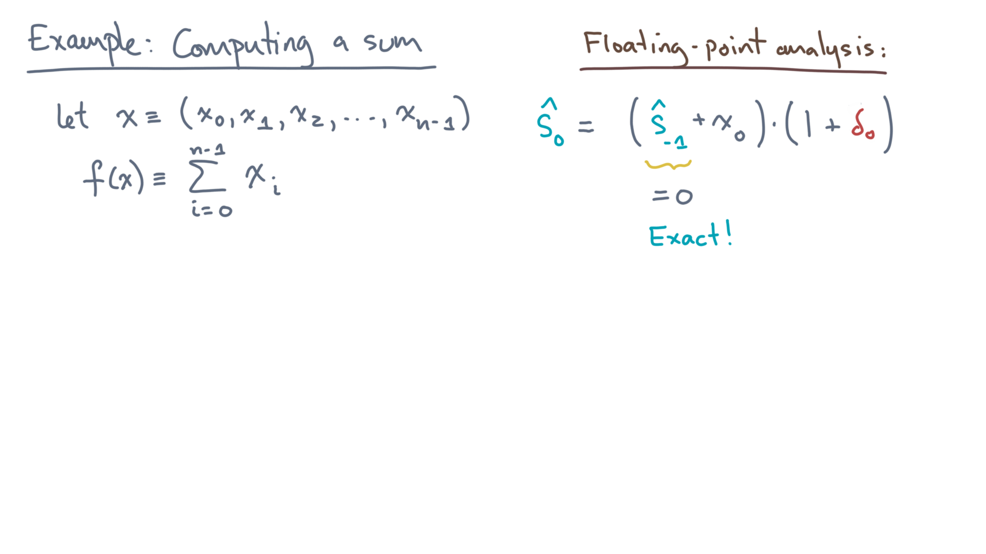
def alg_sum(x):
s = 0.0
for x_i in x:
s += x_i
return s
Notes:
Therefore, the IEEE-754 standard tells us this operation will be done exactly!
Meaning there is no rounding error.

Slide 16

def alg_sum(x):
s = 0.0
for x_i in x:
s += x_i
return s
Notes:
That is, delta-zero is, well, zero.

Slide 17
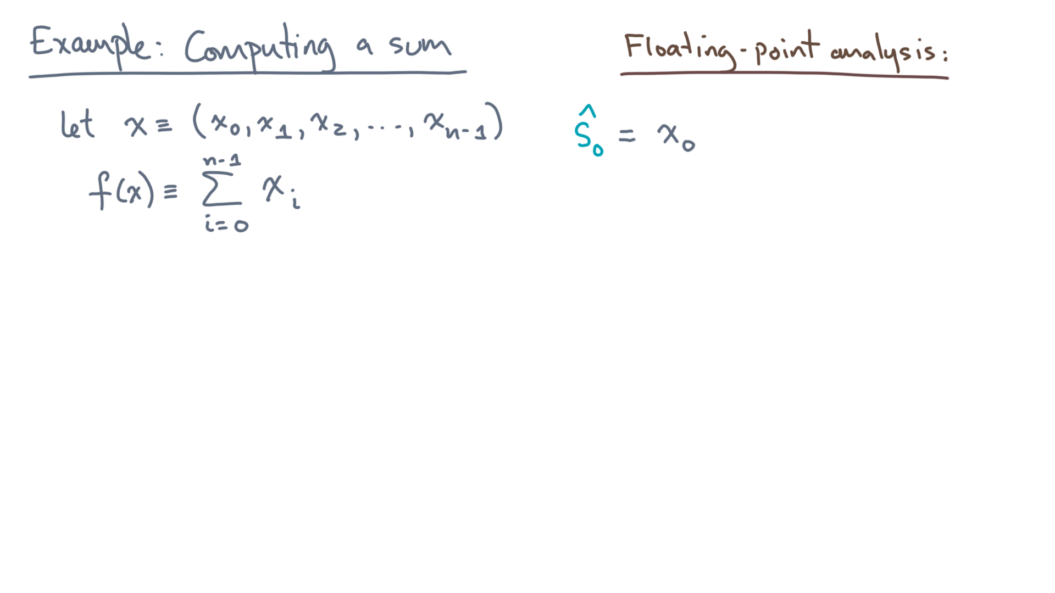
def alg_sum(x):
s = 0.0
for x_i in x:
s += x_i
return s
Notes:
Thus, s-hat-zero is just the first element of x, x-zero.

Slide 18
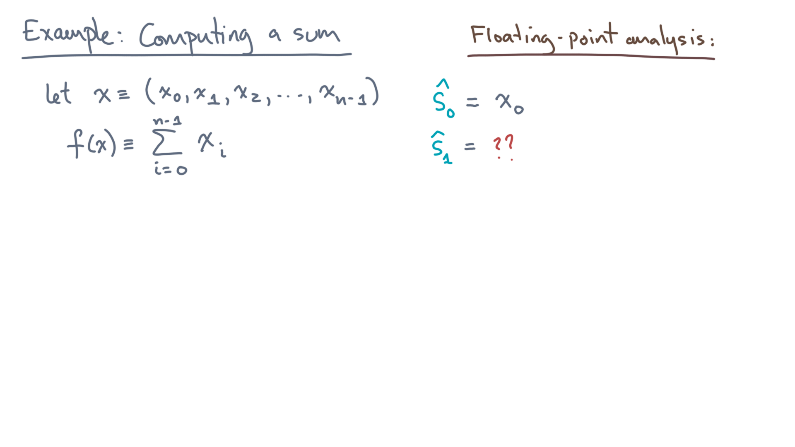
def alg_sum(x):
s = 0.0
for x_i in x:
s += x_i
return s
Notes:
What about the next value of “s”, s-hat-one?

Slide 19
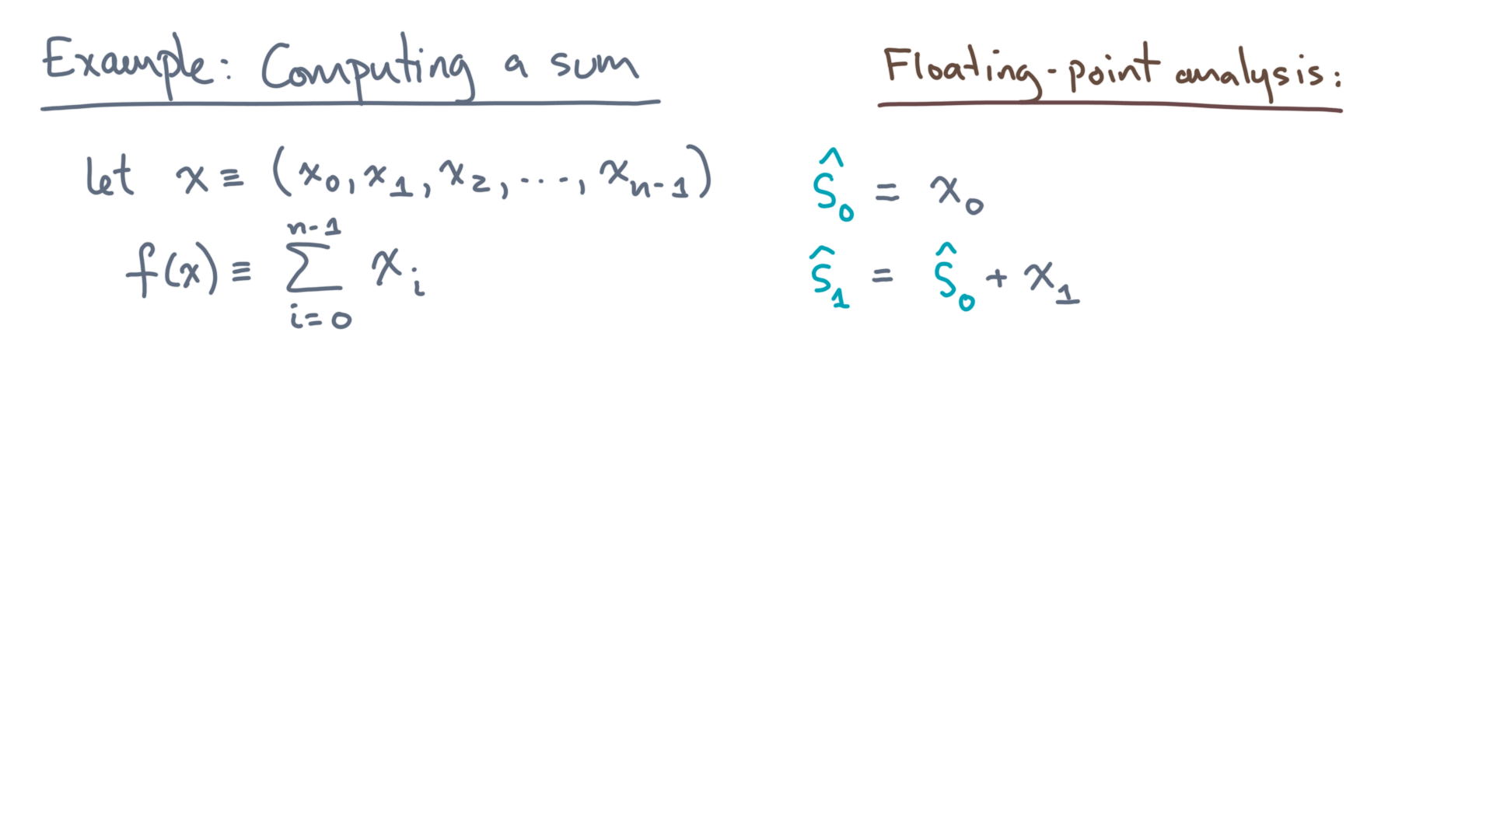
def alg_sum(x):
s = 0.0
for x_i in x:
s += x_i
return s
Notes:
It’s the previous value plus x-one.
But of course, this is floating-point.

Slide 20
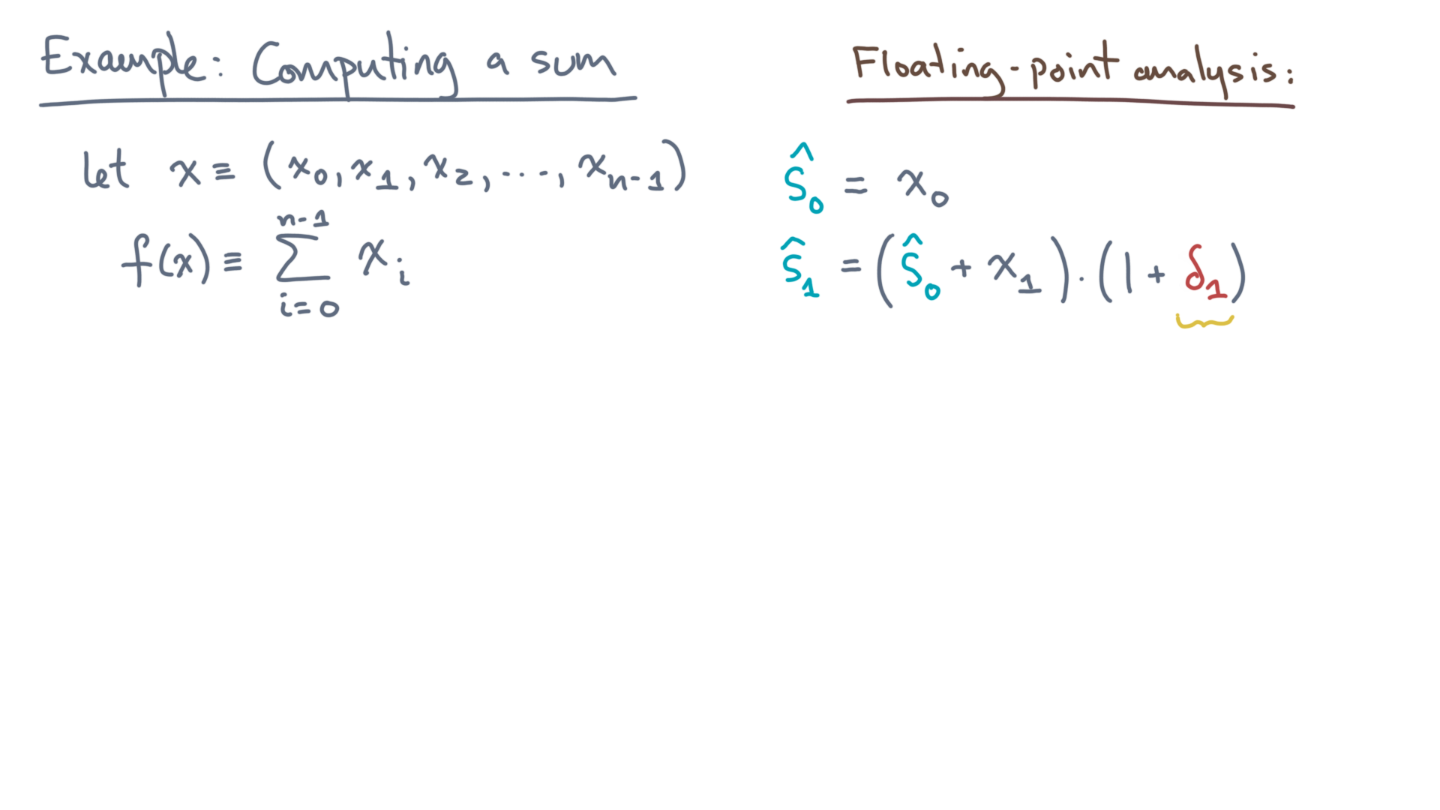
def alg_sum(x):
s = 0.0
for x_i in x:
s += x_i
return s
Notes:
Therefore, there will be some rounding error. Let’s call it delta-one.
Now here, we have to start tracking the error because s-hat-zero and x-one could be arbitrary values.

Slide 21
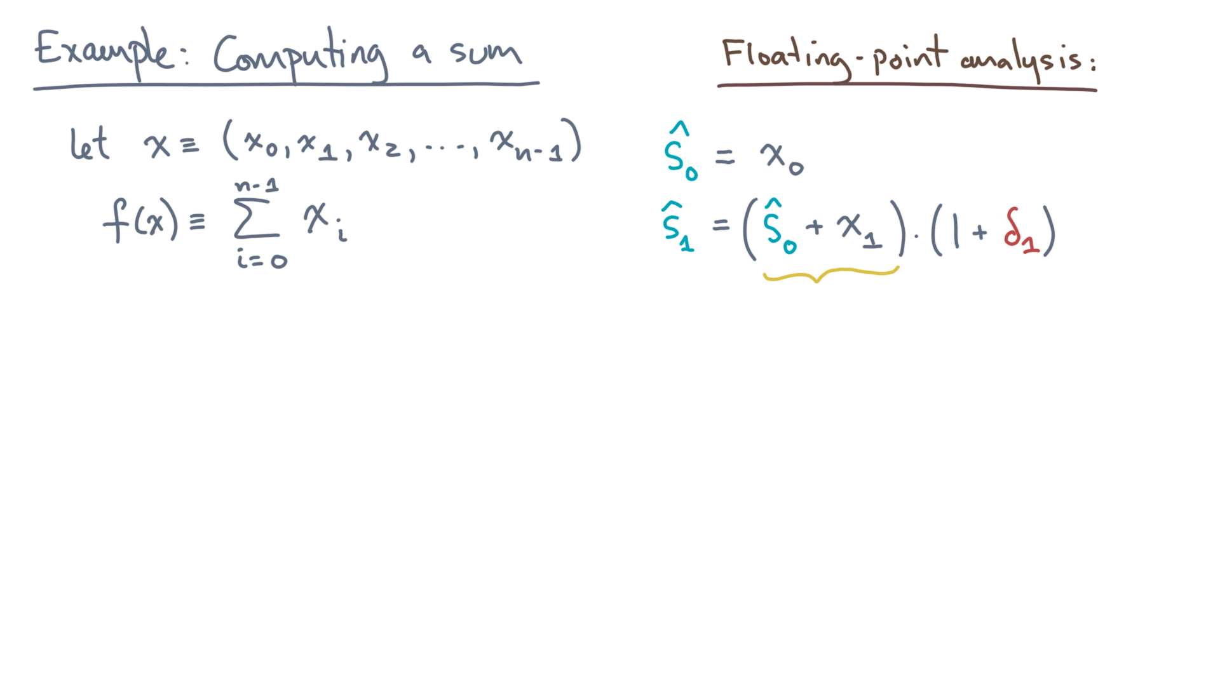
def alg_sum(x):
s = 0.0
for x_i in x:
s += x_i
return s
Notes:
Now consider this first factor, s-hat-zero + x-one.

Slide 22
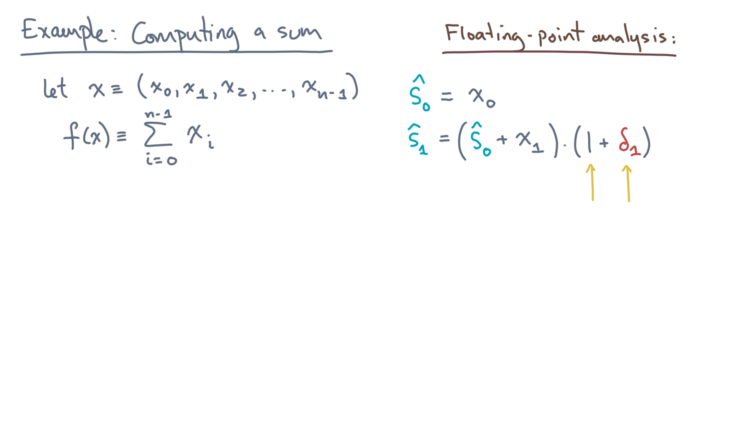
def alg_sum(x):
s = 0.0
for x_i in x:
s += x_i
return s
Notes:
Let’s multiply against the second factor, term by term.
Here is the result.

Slide 23
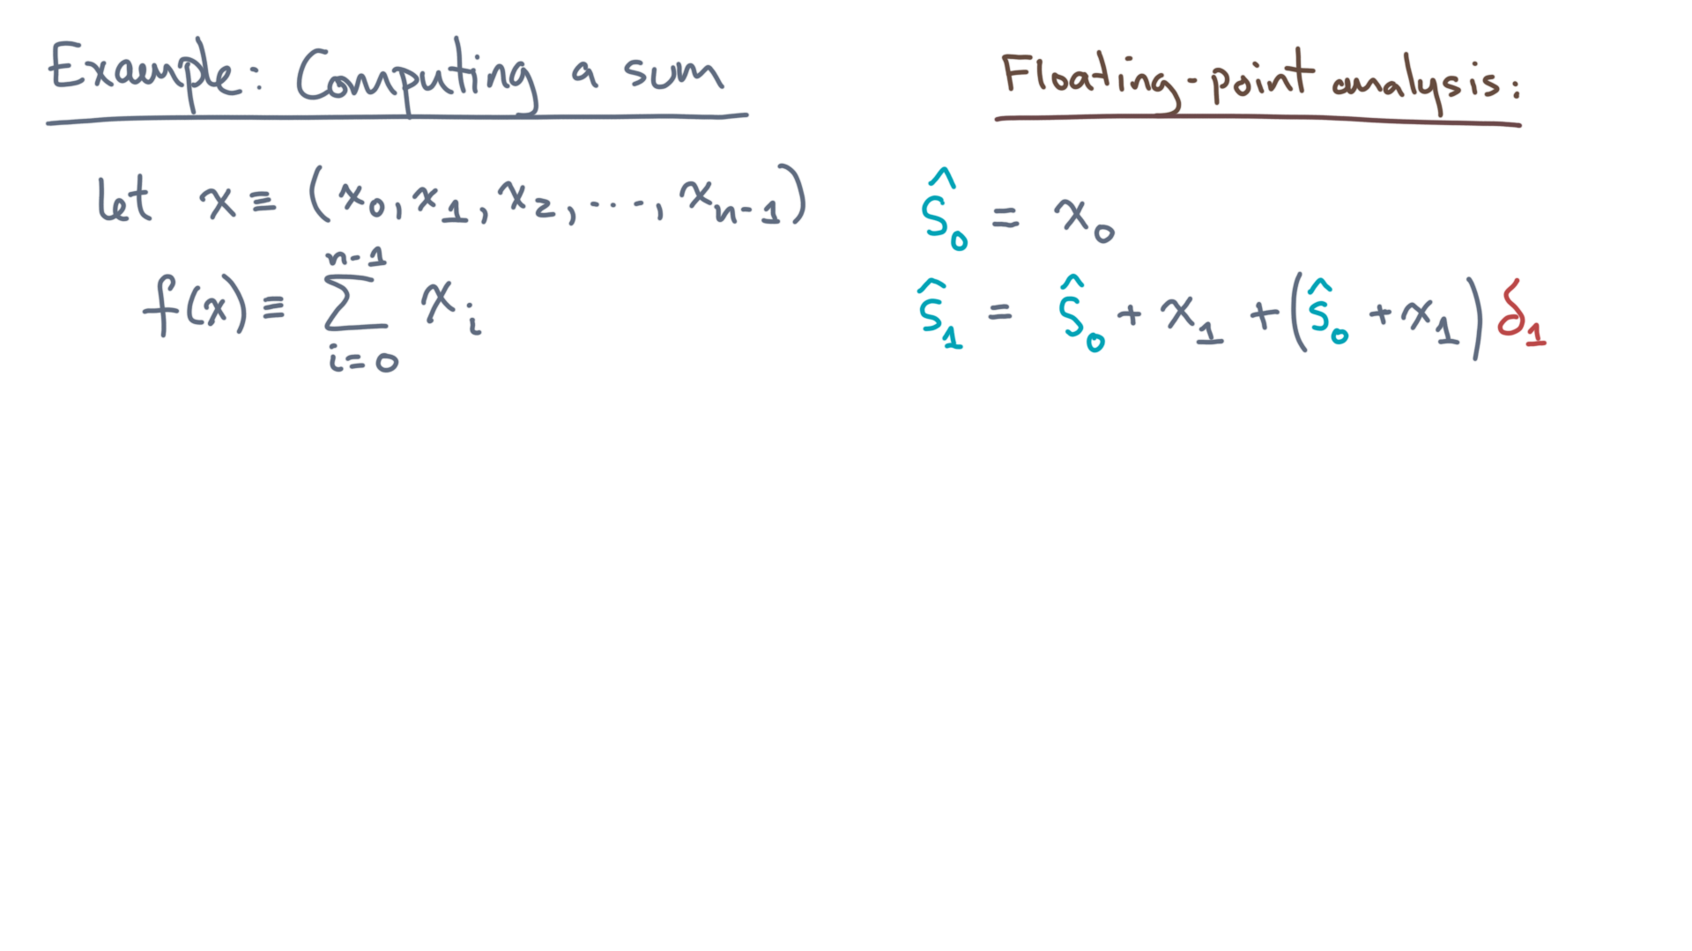
def alg_sum(x):
s = 0.0
for x_i in x:
s += x_i
return s
Notes:
It’s the first factor, s-hat-zero plus x-one, plus that same factor quantity times delta-one.

Slide 24
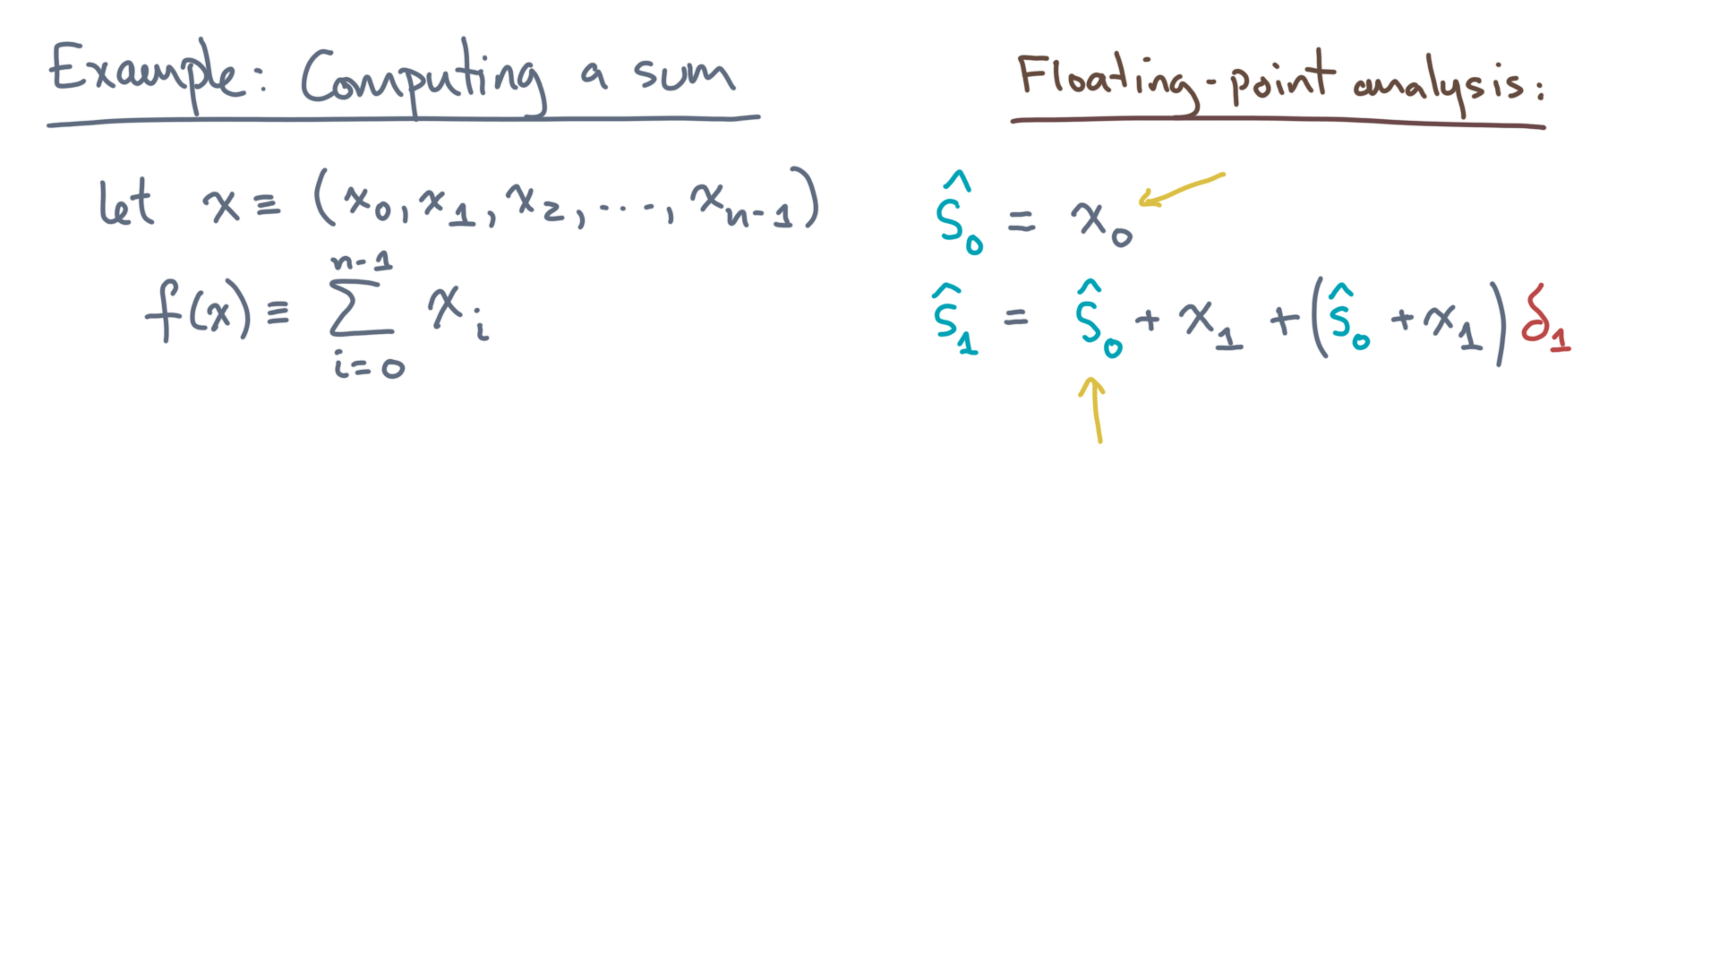
def alg_sum(x):
s = 0.0
for x_i in x:
s += x_i
return s
Notes:
Recall that s-hat-zero is just x-zero.
Using that fact, you’ll get this:

Slide 25
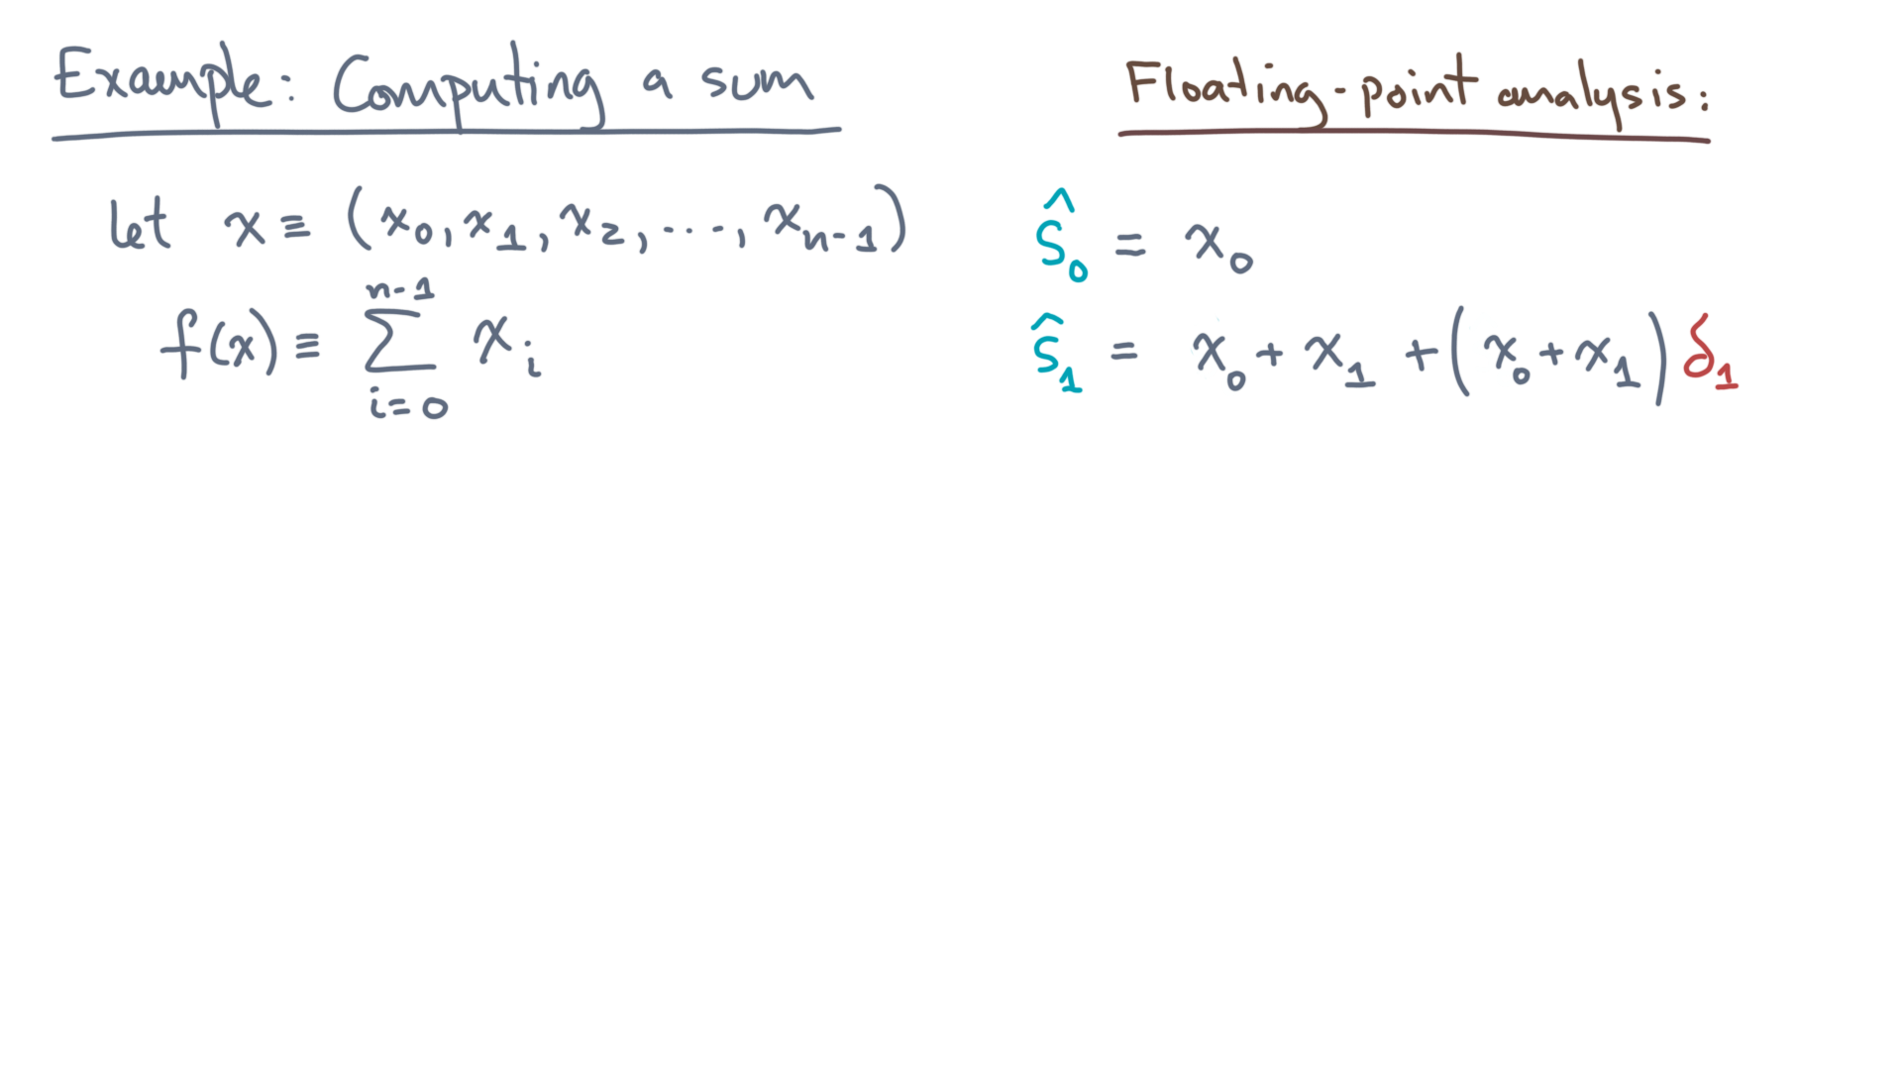
def alg_sum(x):
s = 0.0
for x_i in x:
s += x_i
return s
Notes:
X-zero plus x-one, plus the quantity (x-zero plus x-one) times delta-one.

Slide 26
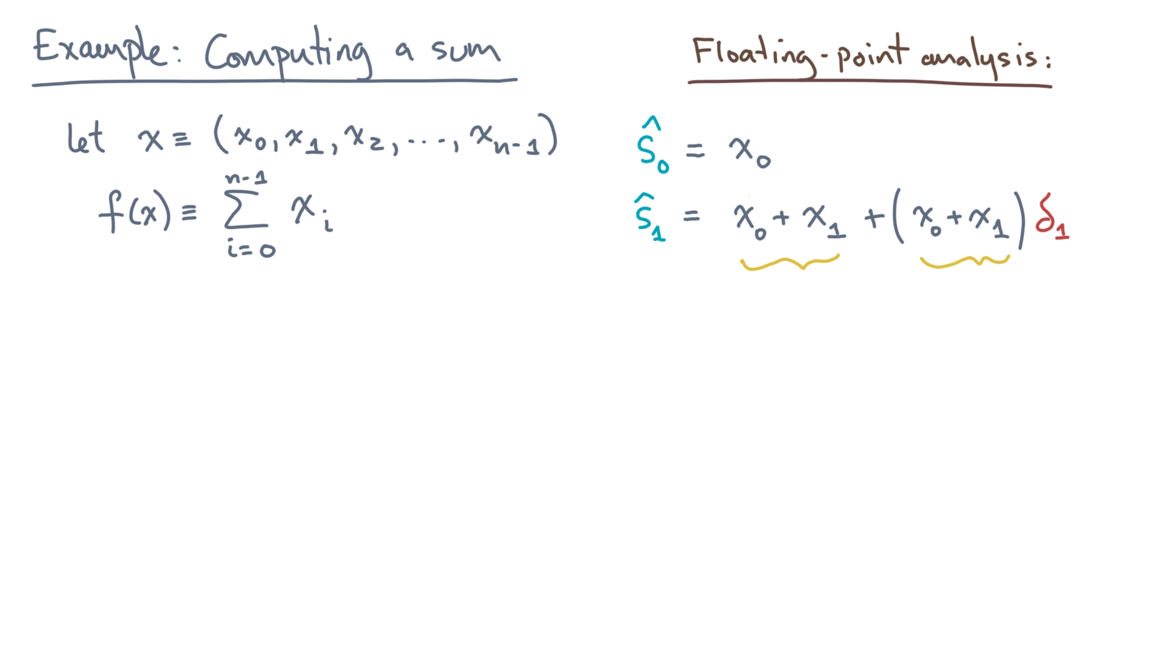
def alg_sum(x):
s = 0.0
for x_i in x:
s += x_i
return s
Notes:
And what is x-zero plus x-one?

Slide 27
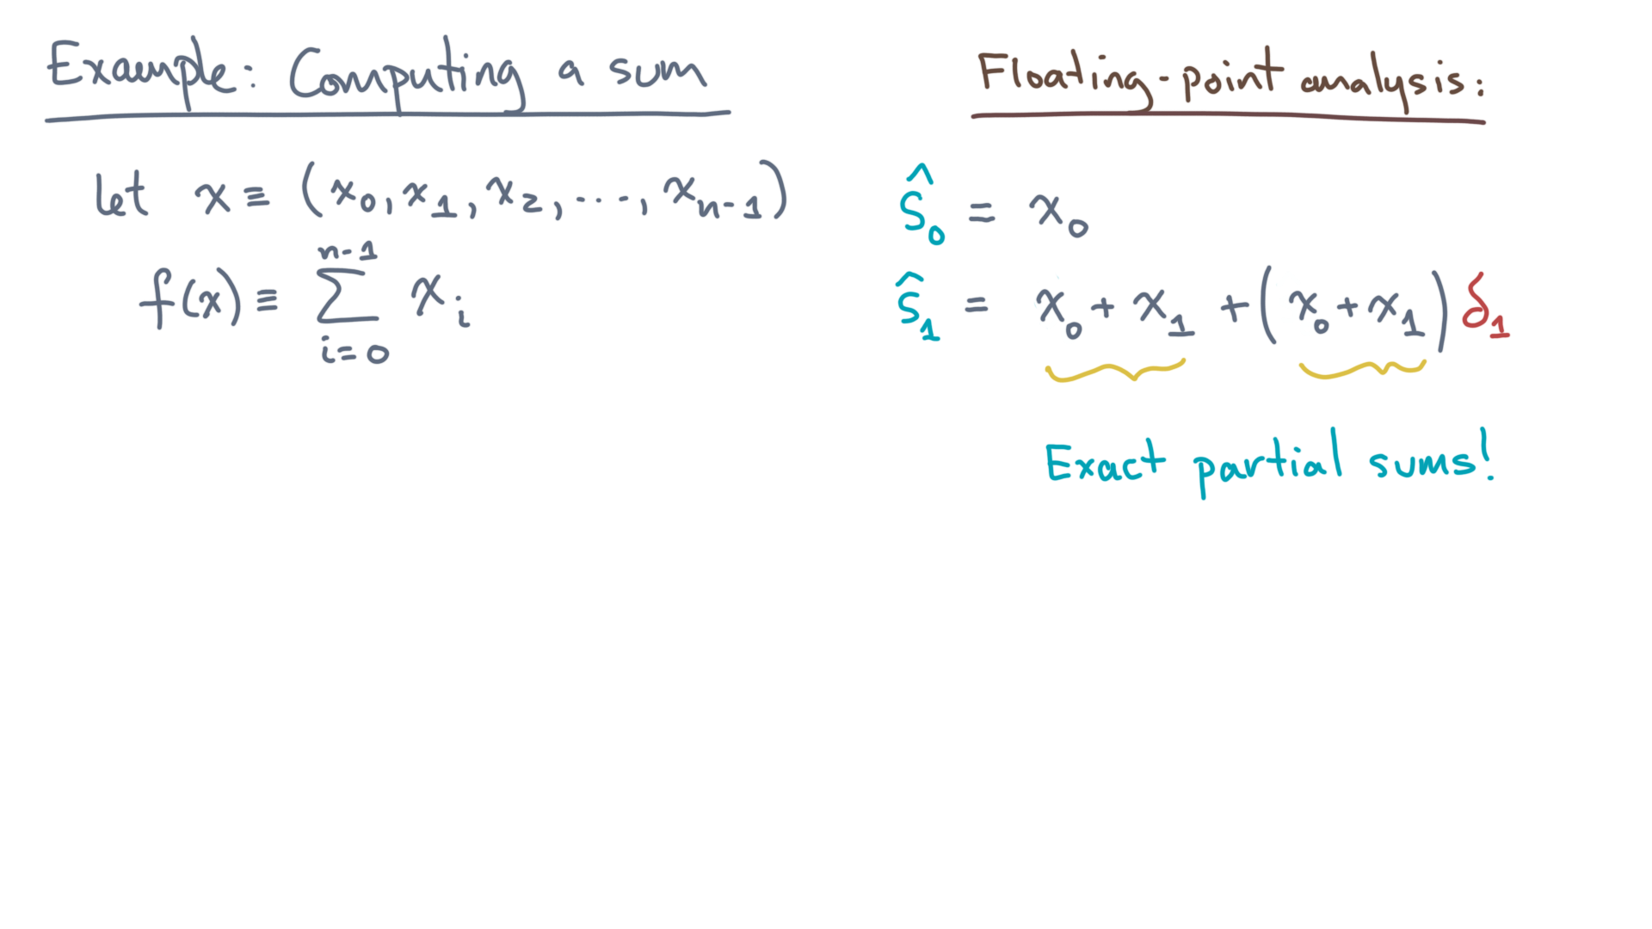
def alg_sum(x):
s = 0.0
for x_i in x:
s += x_i
return s
Notes:
It’s nothing more than the *exact* partial sums up to x-one!
Indeed, let’s introduce one more bit of notation.

Slide 28
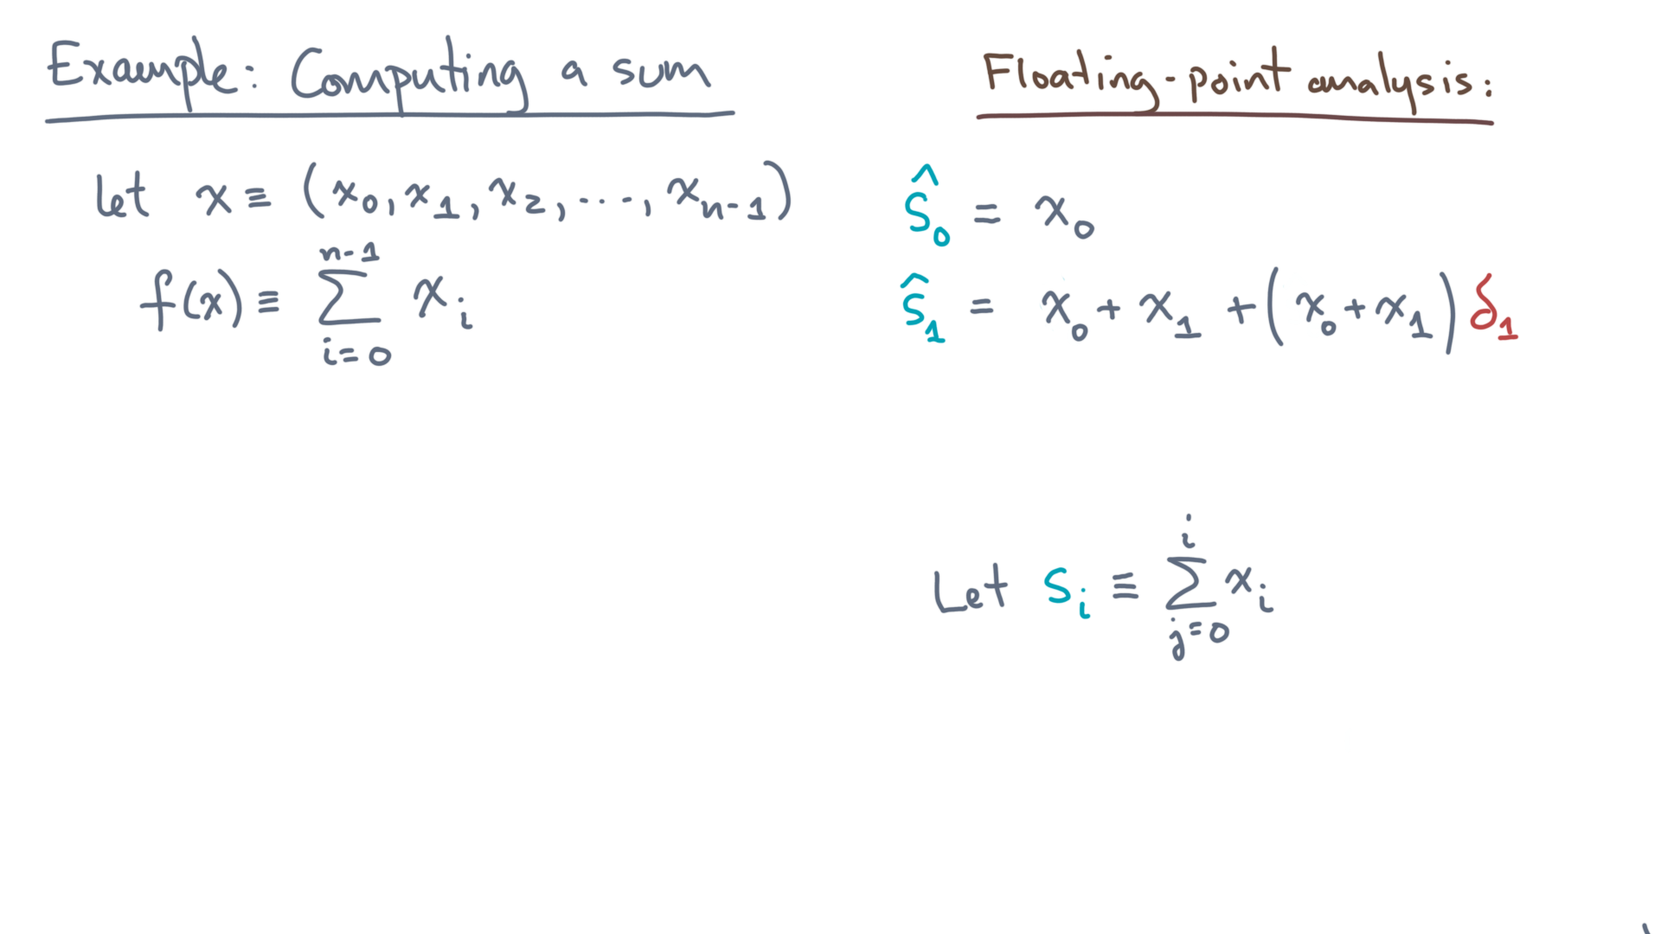
def alg_sum(x):
s = 0.0
for x_i in x:
s += x_i
return s
Notes:
Let s-sub-i, without any hat, denote the *exact* partial sum from x-zero up through and including x-i.

Slide 29

def alg_sum(x):
s = 0.0
for x_i in x:
s += x_i
return s
Notes:
Then s-hat-zero is s-zero.
In other words, the first computed element is exact.
And what about s-hat-one?

Slide 30
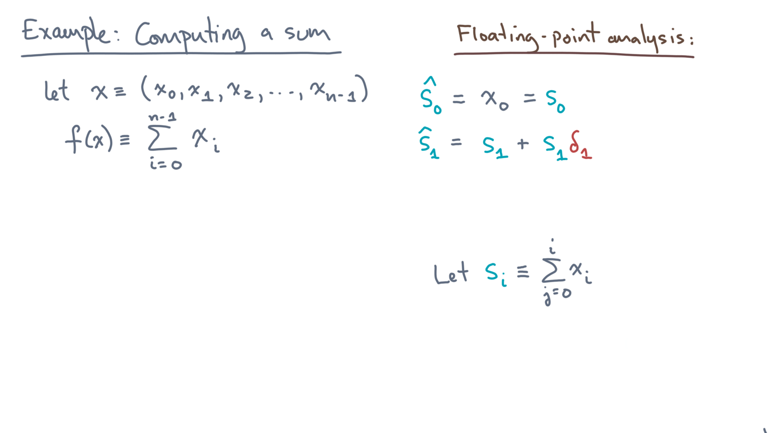
def alg_sum(x):
s = 0.0
for x_i in x:
s += x_i
return s
Notes:
It’s just the exactly partial sum s-one plus s-one times delta-one.
Let’s do this one more time, so you can start to see the pattern.

Slide 31
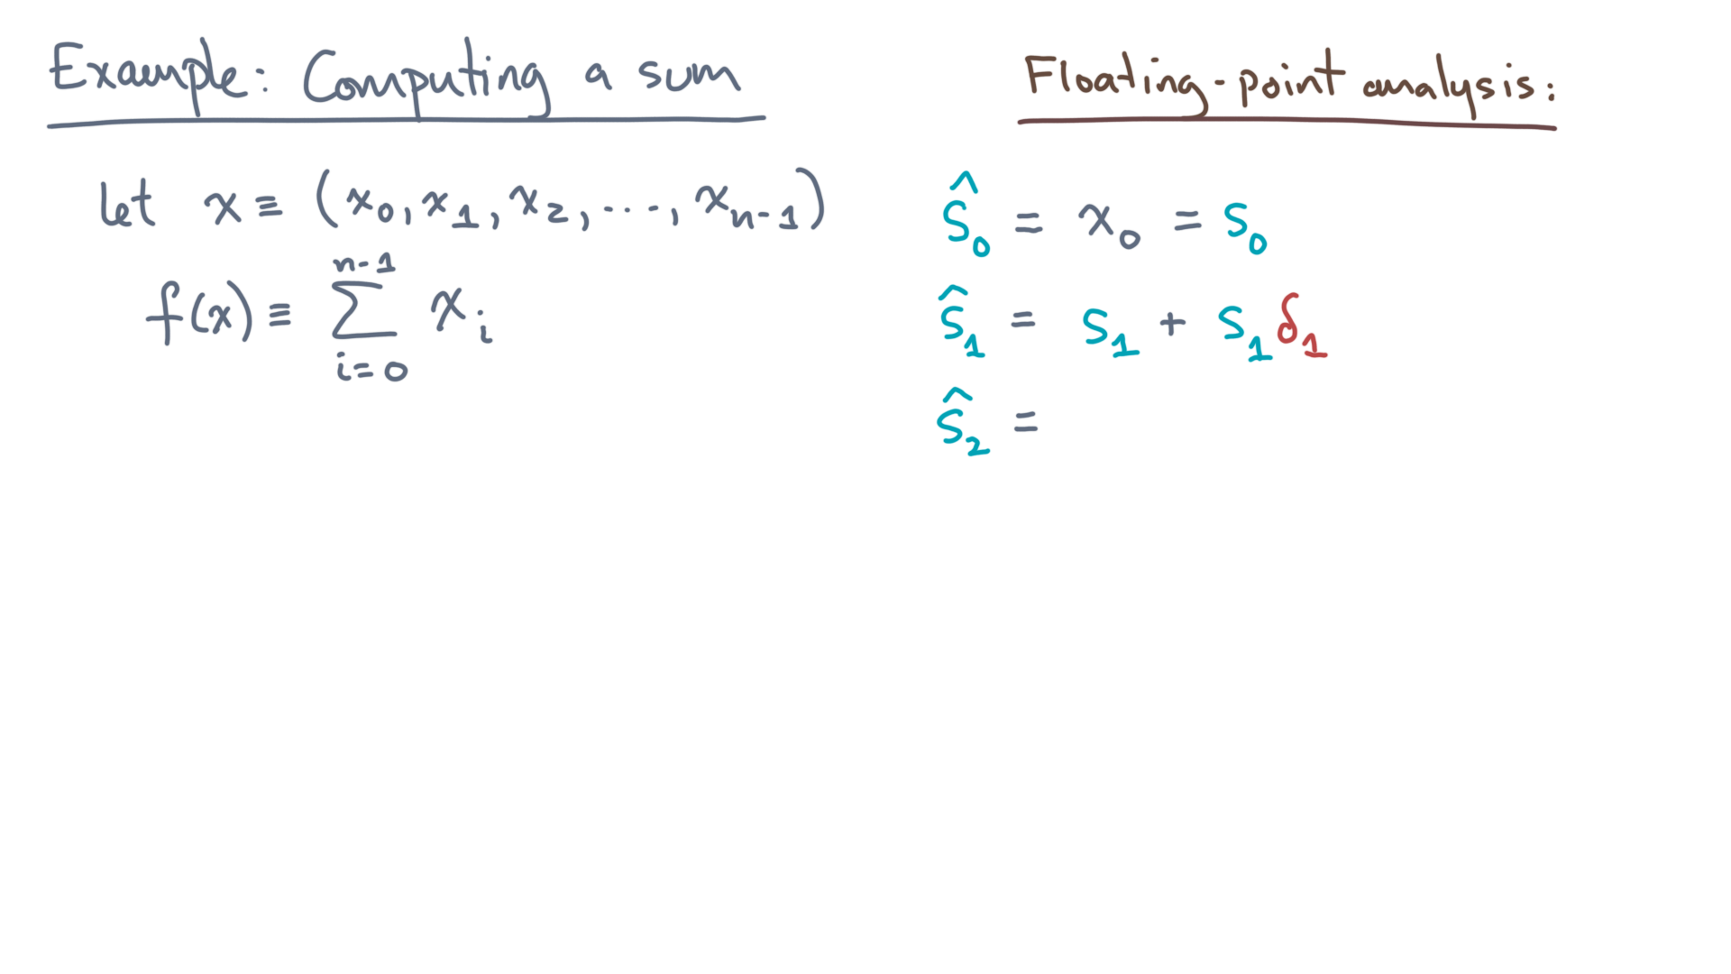
def alg_sum(x):
s = 0.0
for x_i in x:
s += x_i
return s
Notes:
You want to compute s-hat-2.
Of course, it’s the previous value plus x-2.

Slide 32
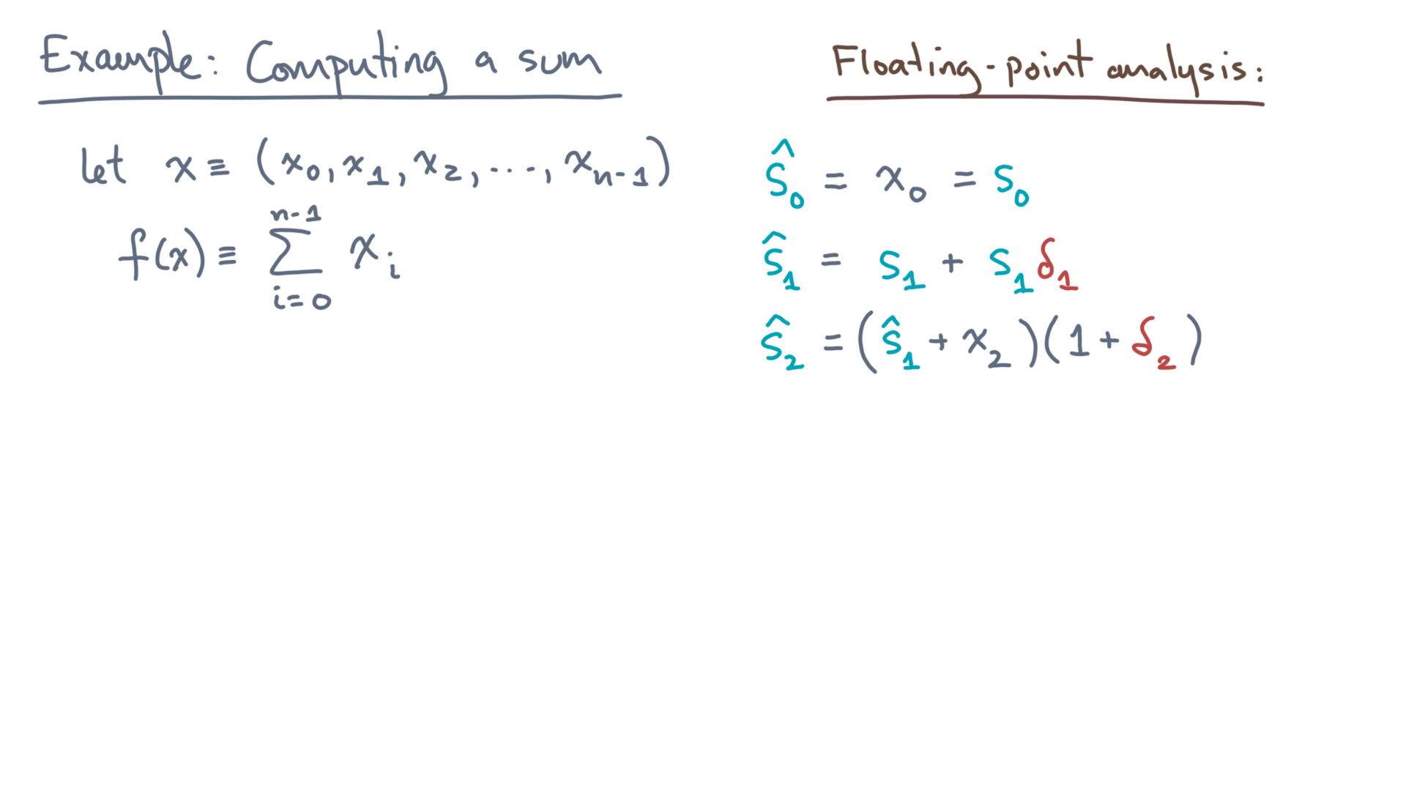
def alg_sum(x):
s = 0.0
for x_i in x:
s += x_i
return s
Notes:
And naturally, that’s with a possible rounding error, delta-2.

Slide 33
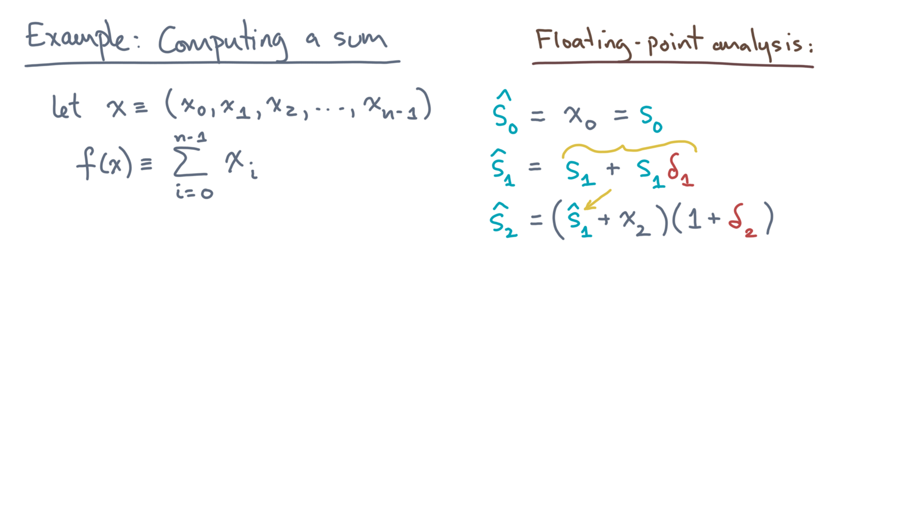
def alg_sum(x):
s = 0.0
for x_i in x:
s += x_i
return s
Notes:
Next, go ahead and substitute the known expression for s-hat-one.
What do you get?

Slide 34
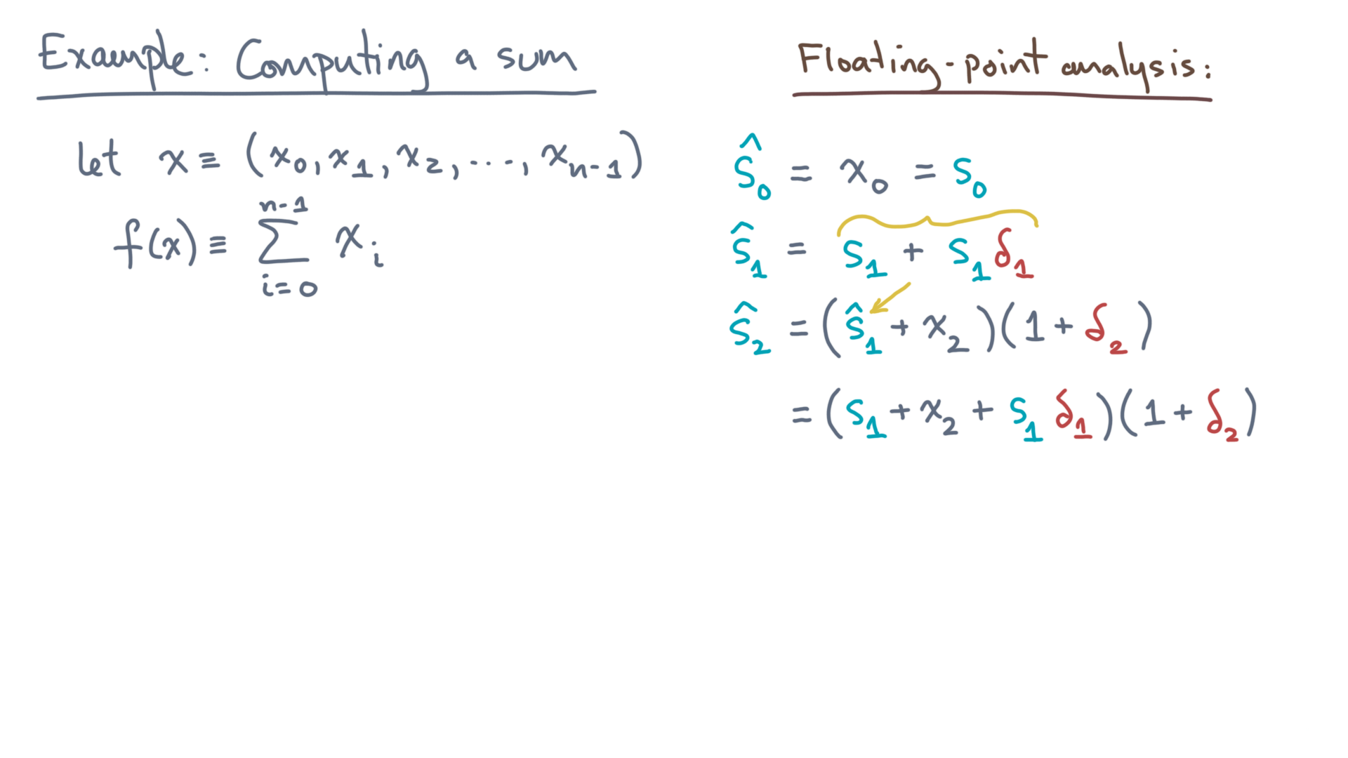
def alg_sum(x):
s = 0.0
for x_i in x:
s += x_i
return s
Notes:
You get this mumbo jumbo.
Notice there is another partial sum.

Slide 35
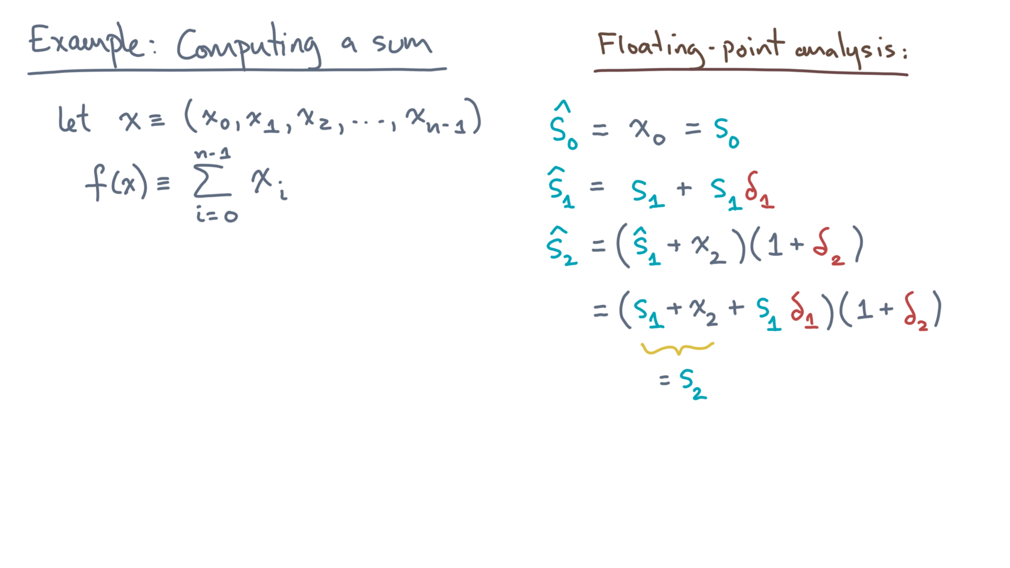
def alg_sum(x):
s = 0.0
for x_i in x:
s += x_i
return s
Notes:
That’s s-2.

Slide 36
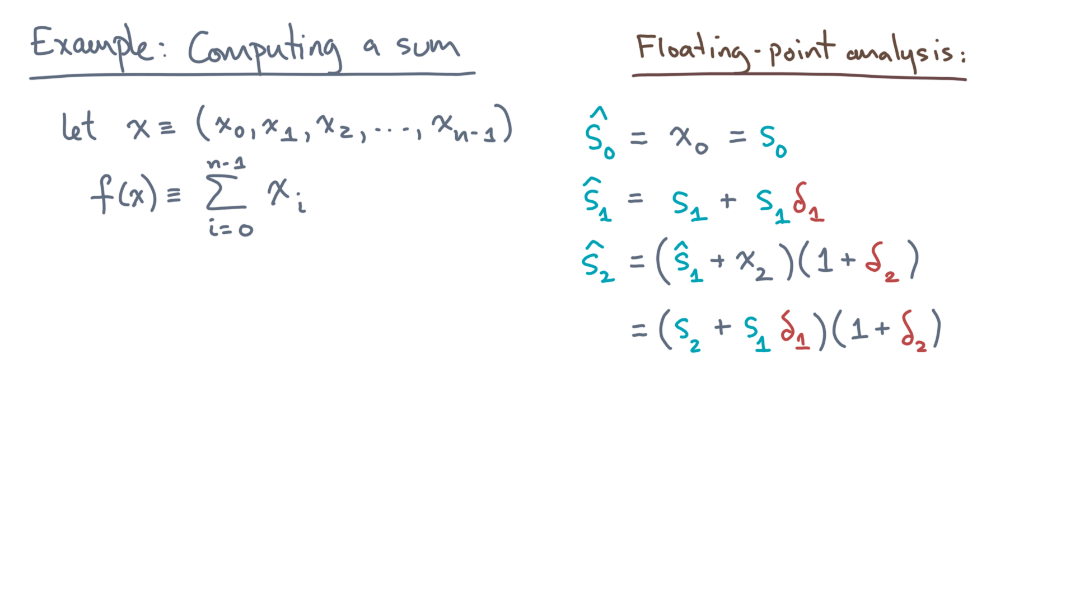
def alg_sum(x):
s = 0.0
for x_i in x:
s += x_i
return s
Notes:
Now let’s distribute the products, as before.

Slide 37
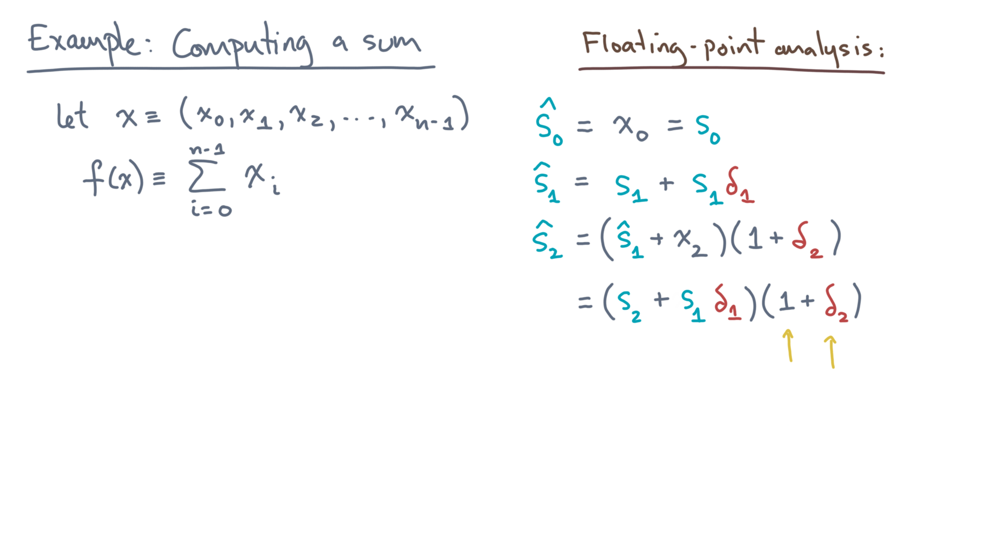
def alg_sum(x):
s = 0.0
for x_i in x:
s += x_i
return s
Notes:
Multiplying it all out, here’s what you’ll get.

Slide 38
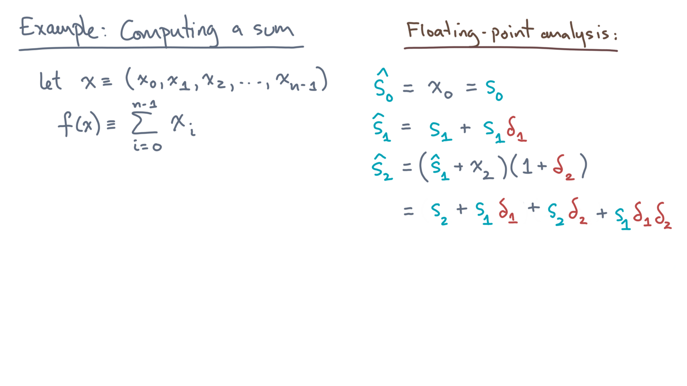
def alg_sum(x):
s = 0.0
for x_i in x:
s += x_i
return s
Notes:
Now inspect the structure.

Slide 39
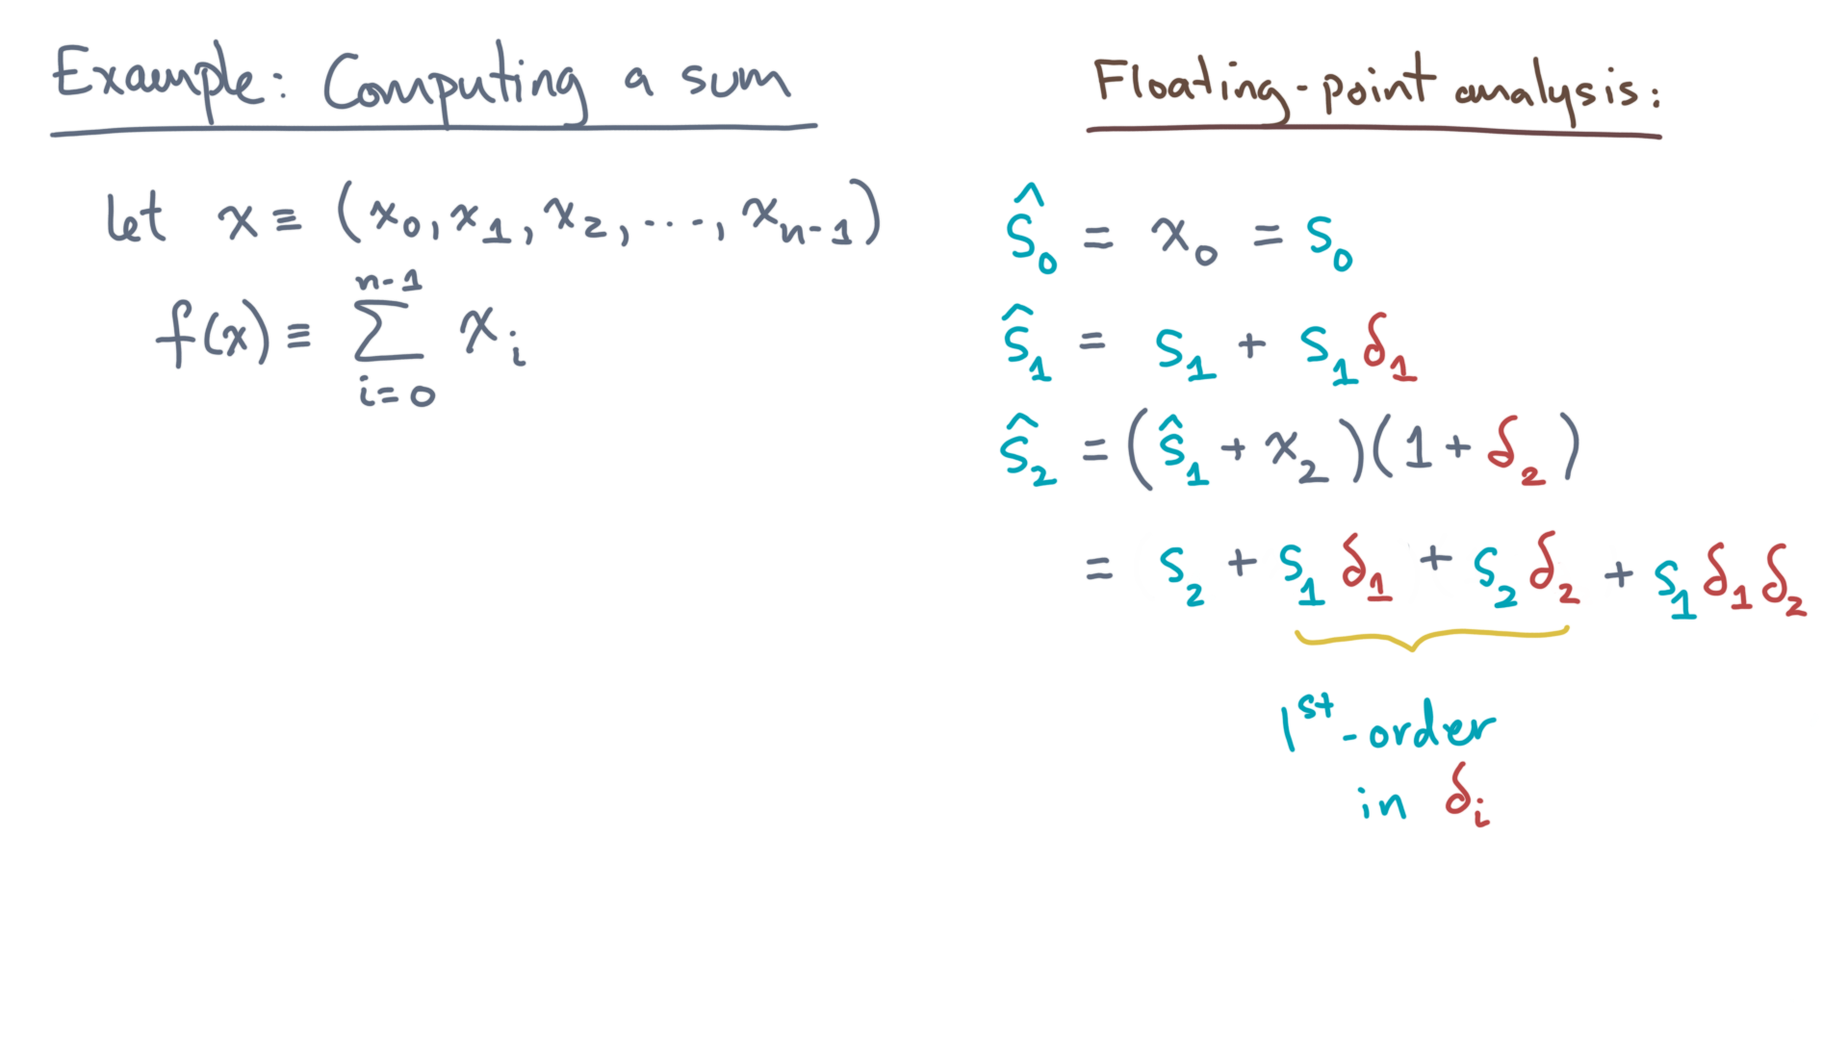
def alg_sum(x):
s = 0.0
for x_i in x:
s += x_i
return s
Notes:
First, there’s a pair of terms that are “first-order” in the deltas.
That is, computed results or inputs times just a single delta.

Slide 40
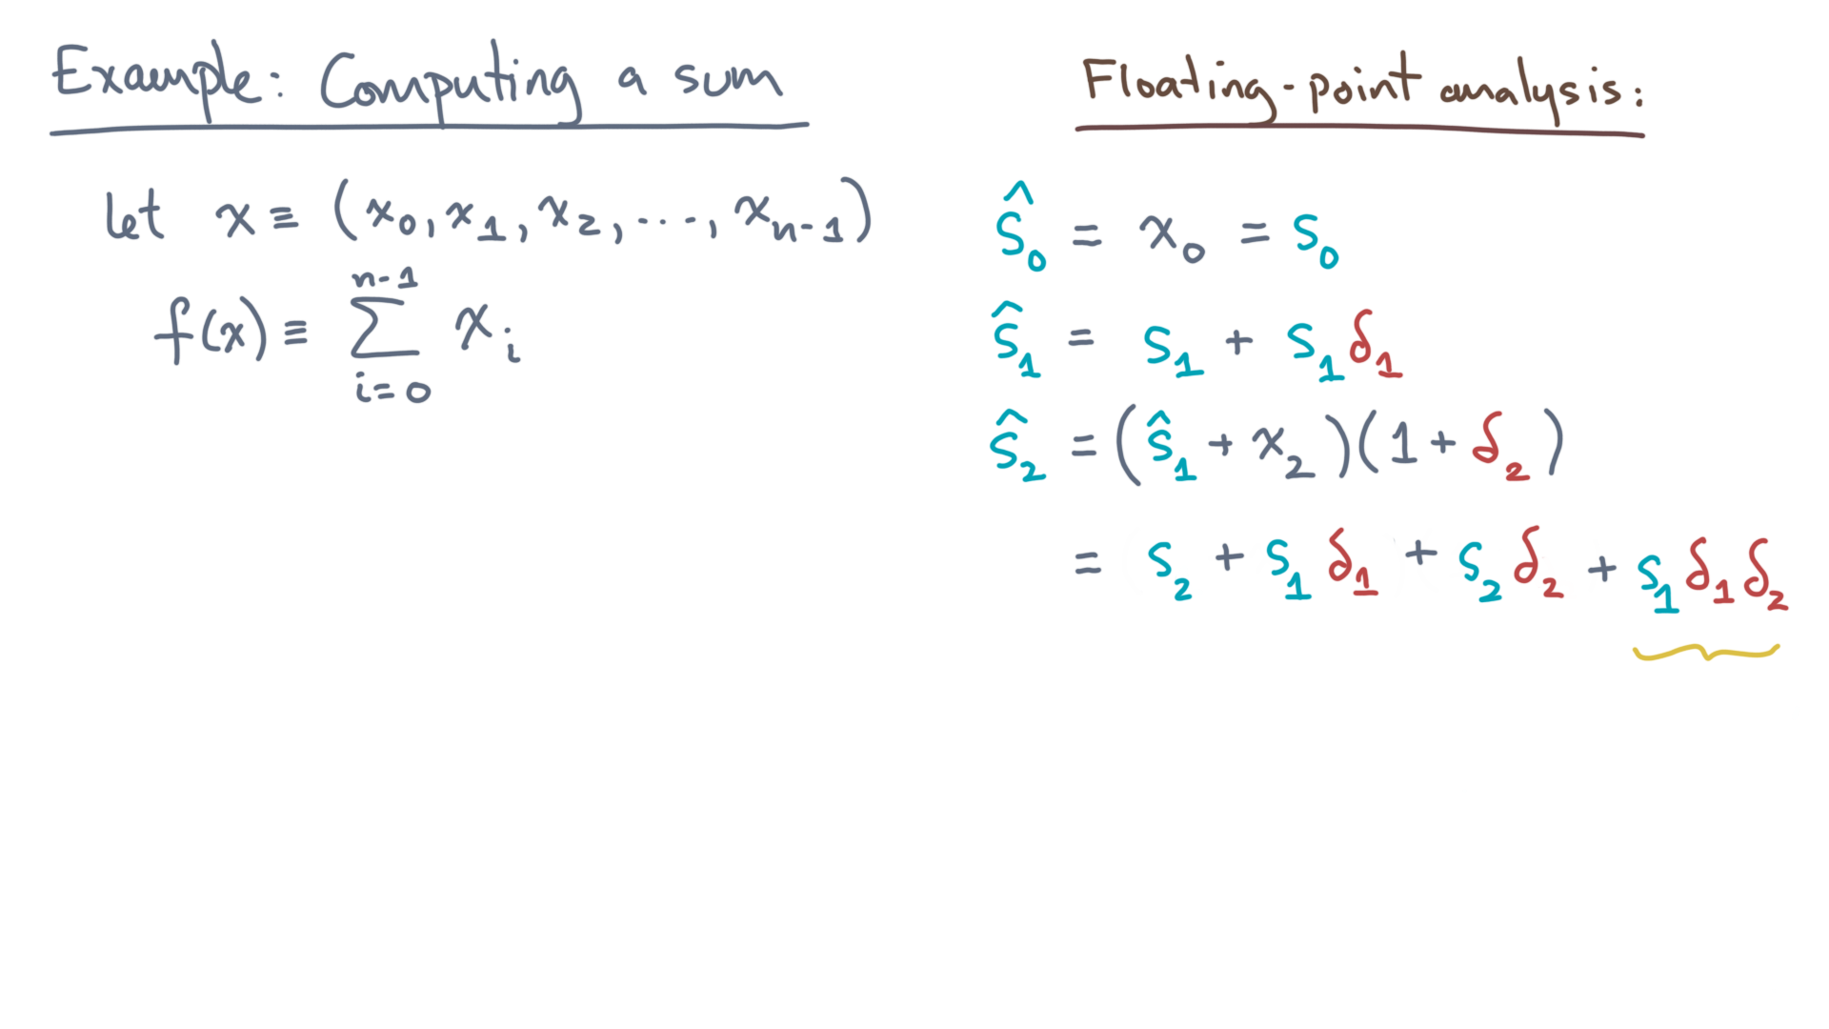
def alg_sum(x):
s = 0.0
for x_i in x:
s += x_i
return s
Notes:
By contrast, look at this last term.
It involves a pair of deltas multiplied, delta-one times delta-2.

Slide 41
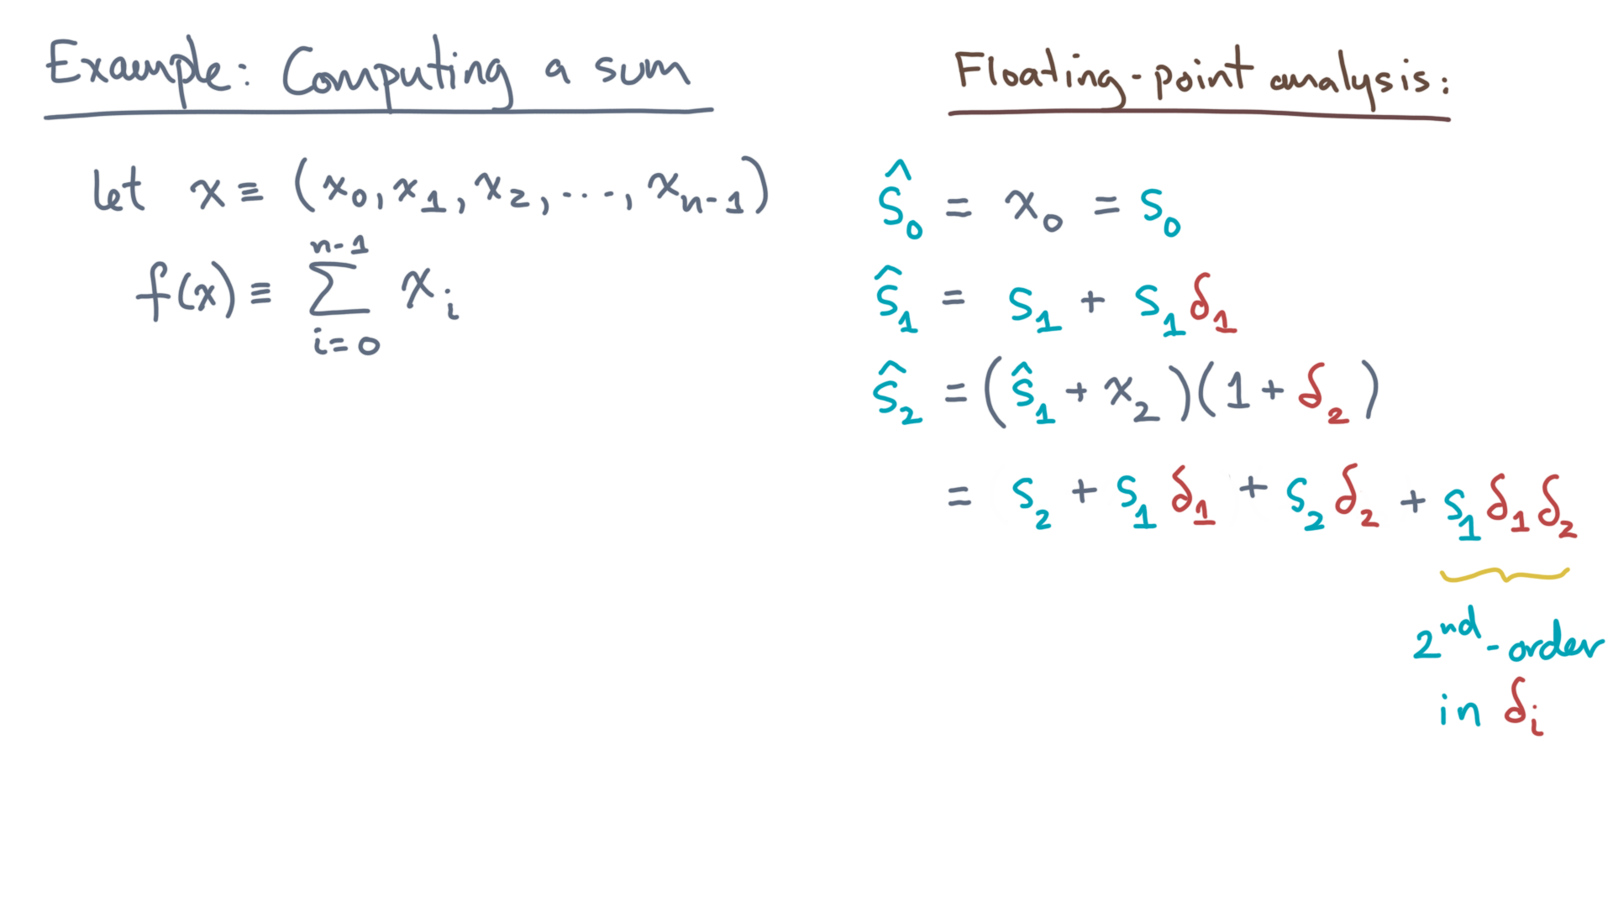
def alg_sum(x):
s = 0.0
for x_i in x:
s += x_i
return s
Notes:
In other words, it’s *second-order* in the deltas.
So why does this matter? You’ll use this fact in a moment.

Slide 42
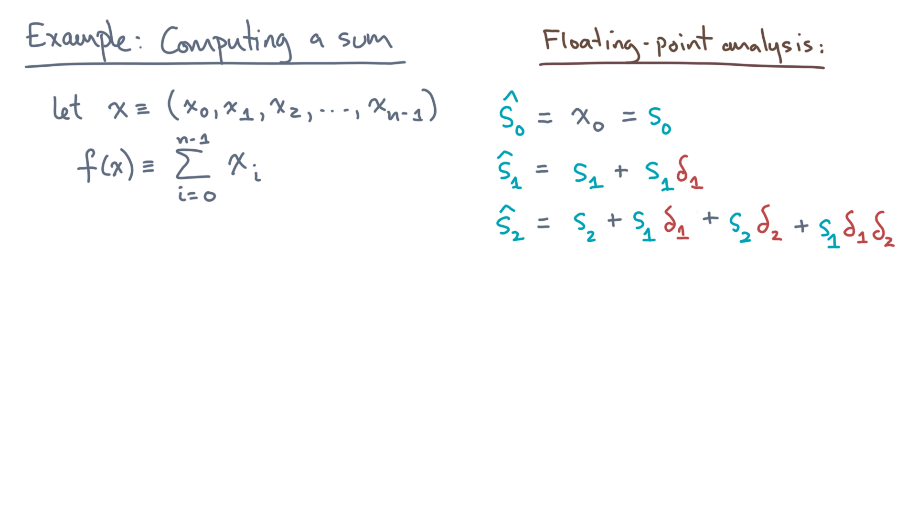
def alg_sum(x):
s = 0.0
for x_i in x:
s += x_i
return s
Notes:
Now you *could* keep going…

Slide 43
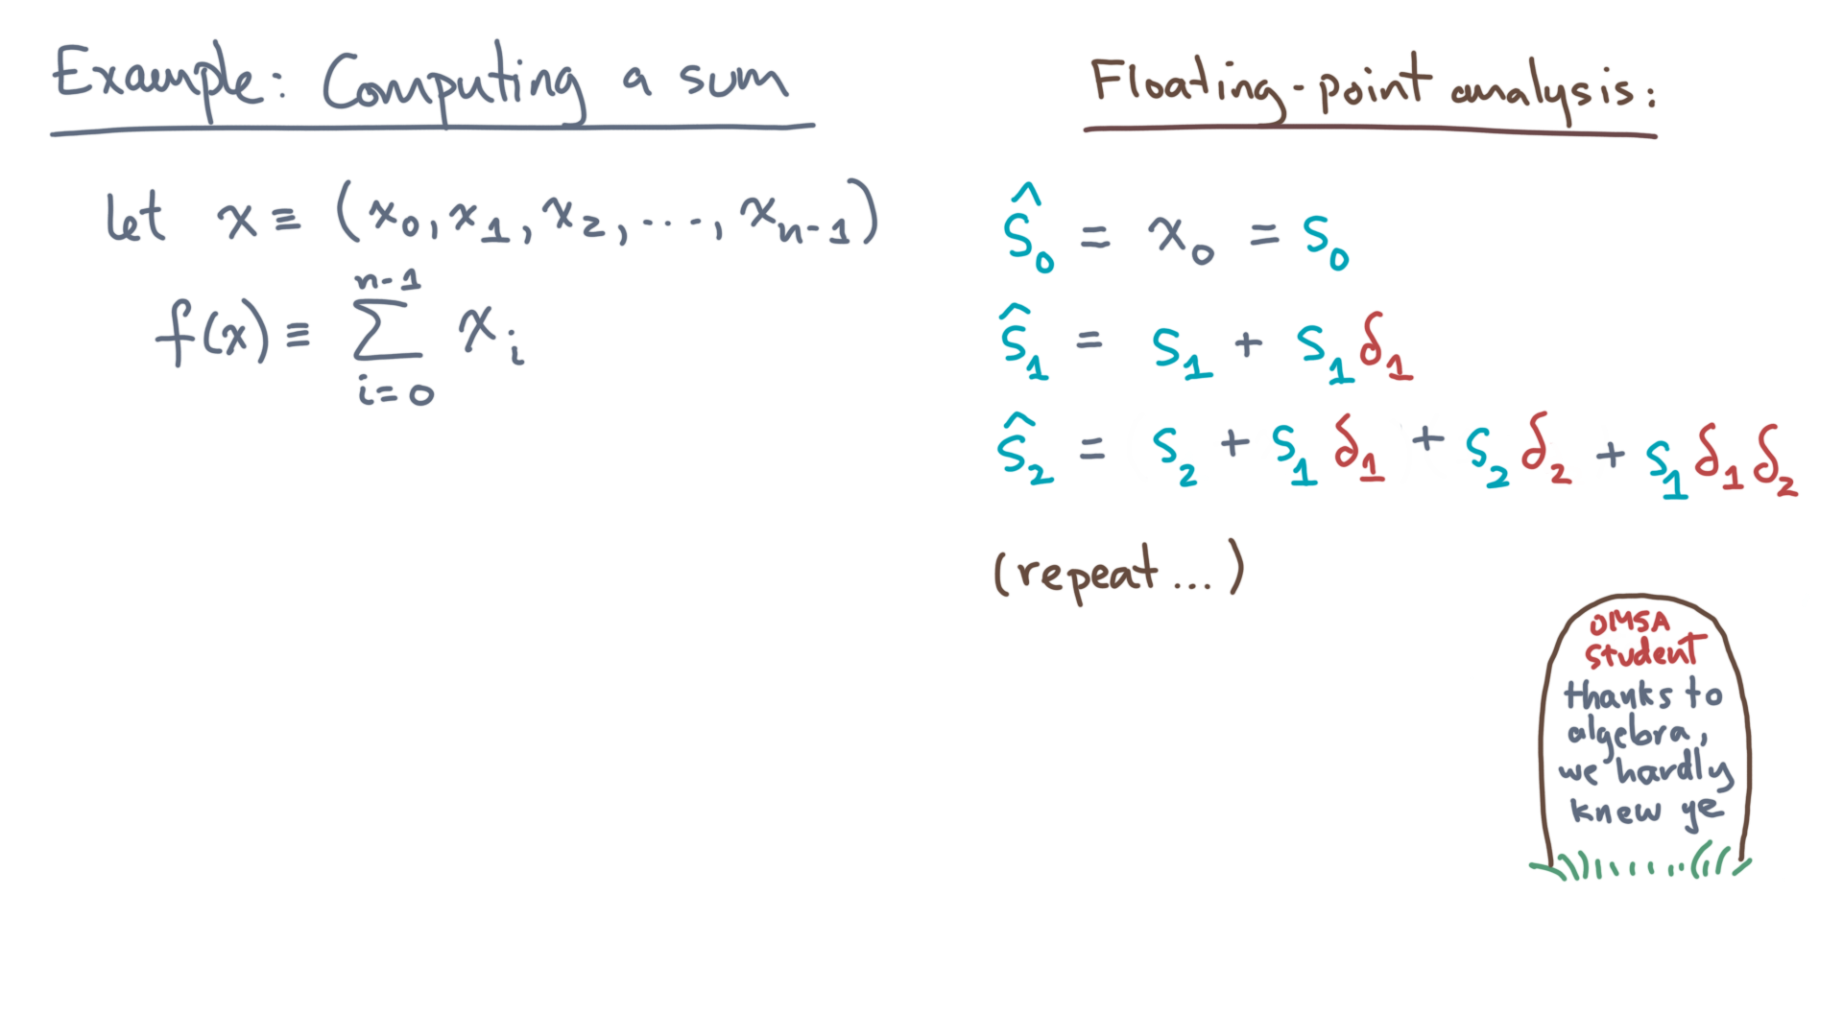
def alg_sum(x):
s = 0.0
for x_i in x:
s += x_i
return s
Notes:
But let me spare you the “death by algebra.”

Slide 44
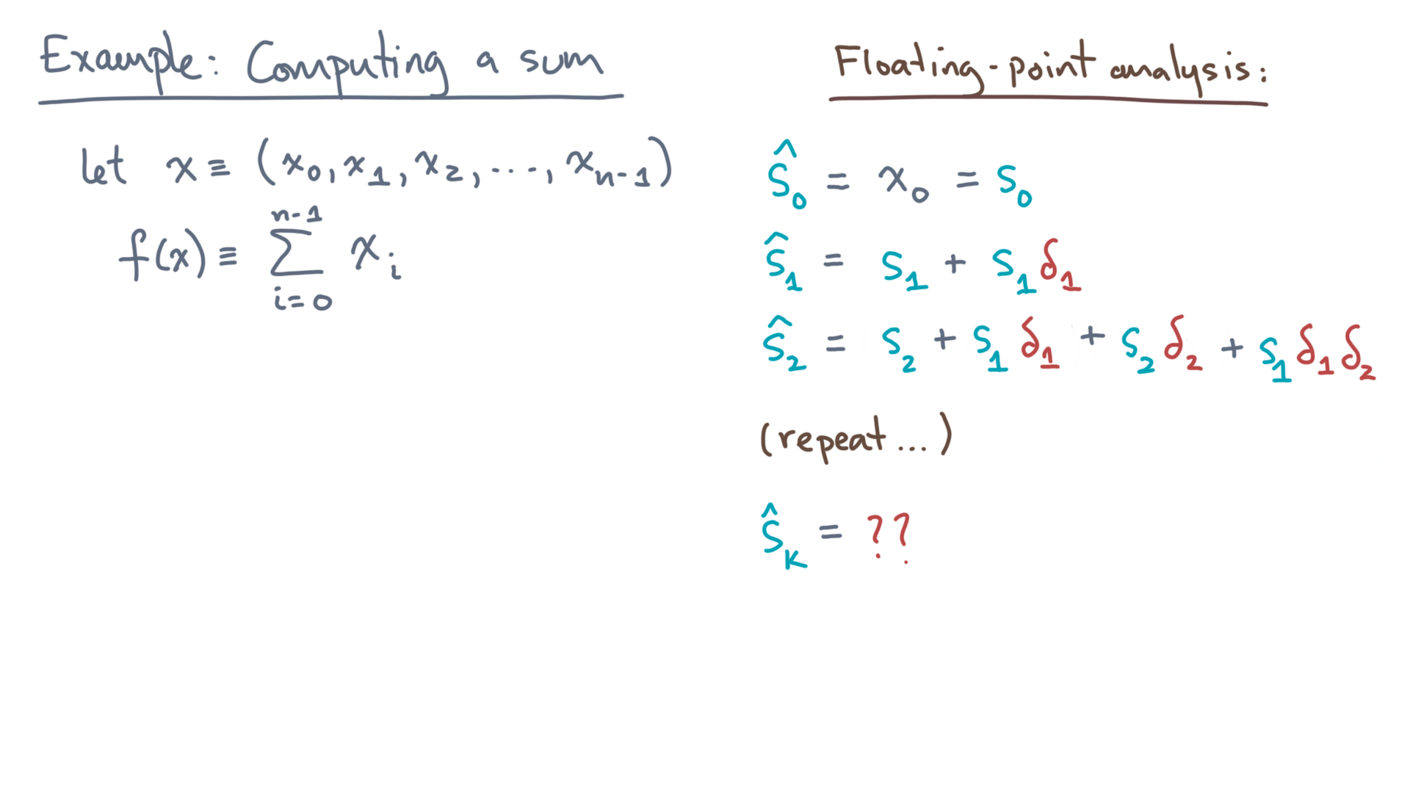
def alg_sum(x):
s = 0.0
for x_i in x:
s += x_i
return s
Notes:
What is the k-th computed value of s?

Slide 45
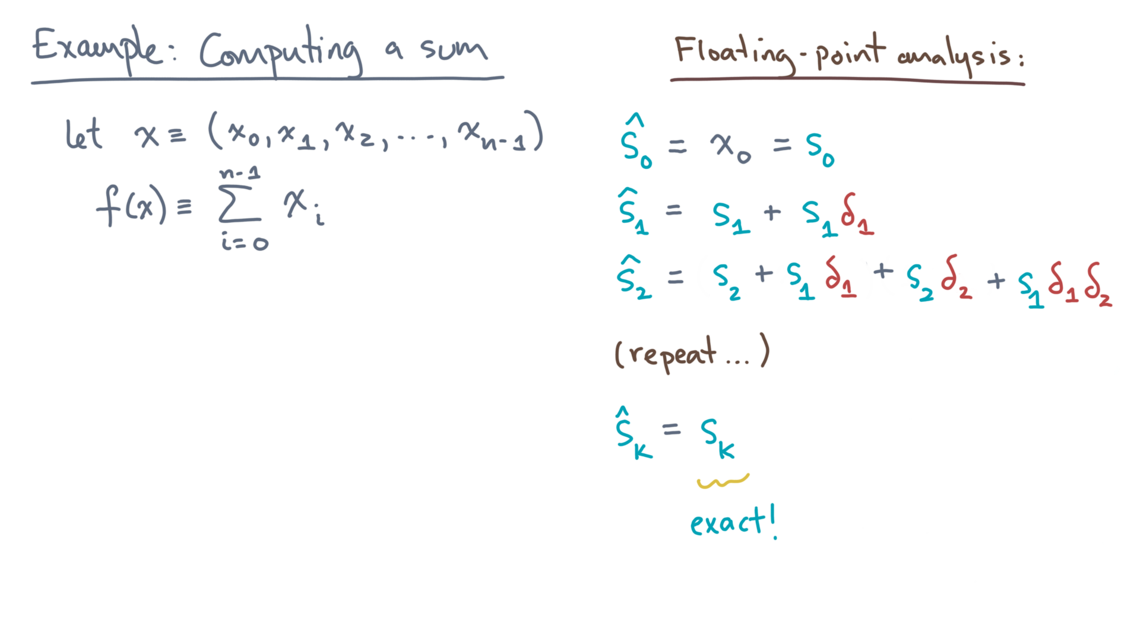
def alg_sum(x):
s = 0.0
for x_i in x:
s += x_i
return s
Notes:
It starts with the *exact* partial sum up to x-k.

Slide 46
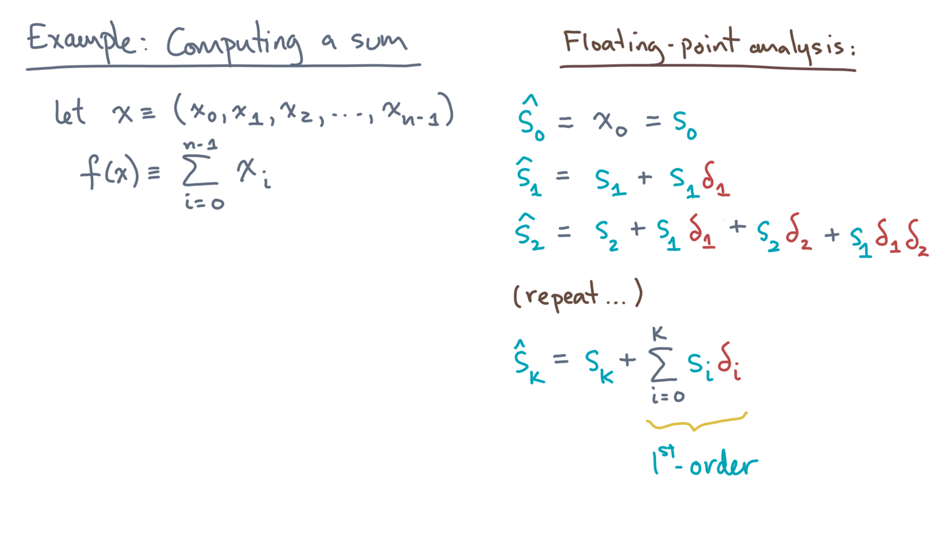
def alg_sum(x):
s = 0.0
for x_i in x:
s += x_i
return s
Notes:
Next, there is a sum of first-order errors.

Slide 47
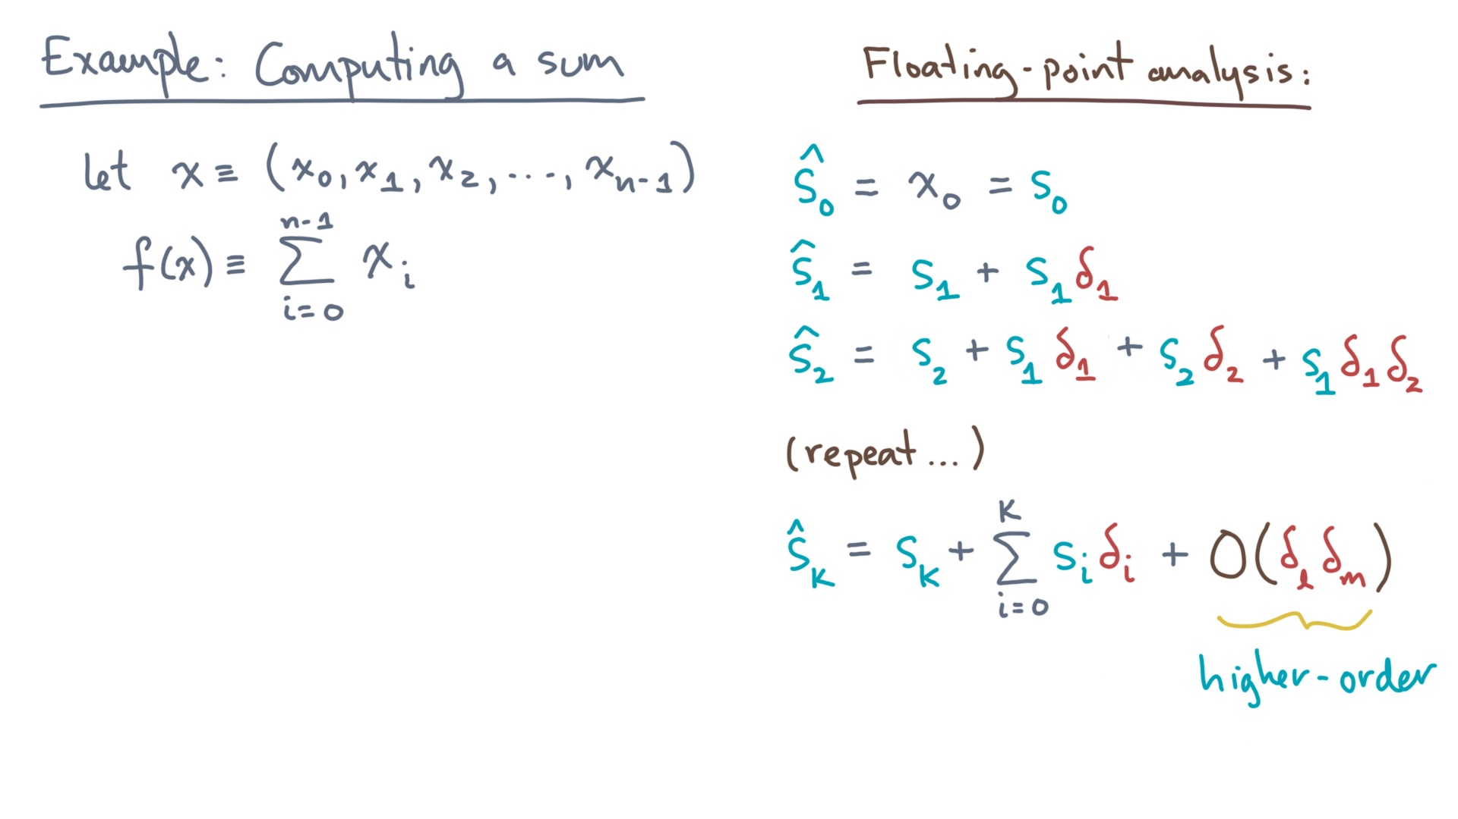
def alg_sum(x):
s = 0.0
for x_i in x:
s += x_i
return s
Notes:
And lastly, there are a bunch of higher-order terms.
These are second-order, third-order, fourth-order, and so on.
We can lump them together. Why?

Slide 48
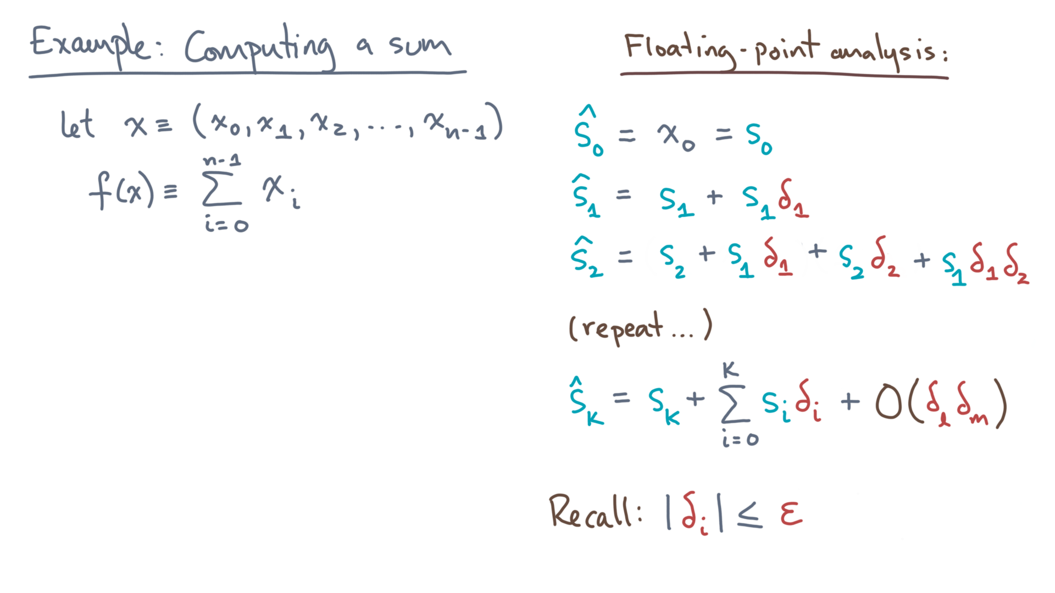
def alg_sum(x):
s = 0.0
for x_i in x:
s += x_i
return s
Notes:
Because they will usually be very tiny!
Remember that these “deltas” are bounded by machine epsilon.

Slide 49
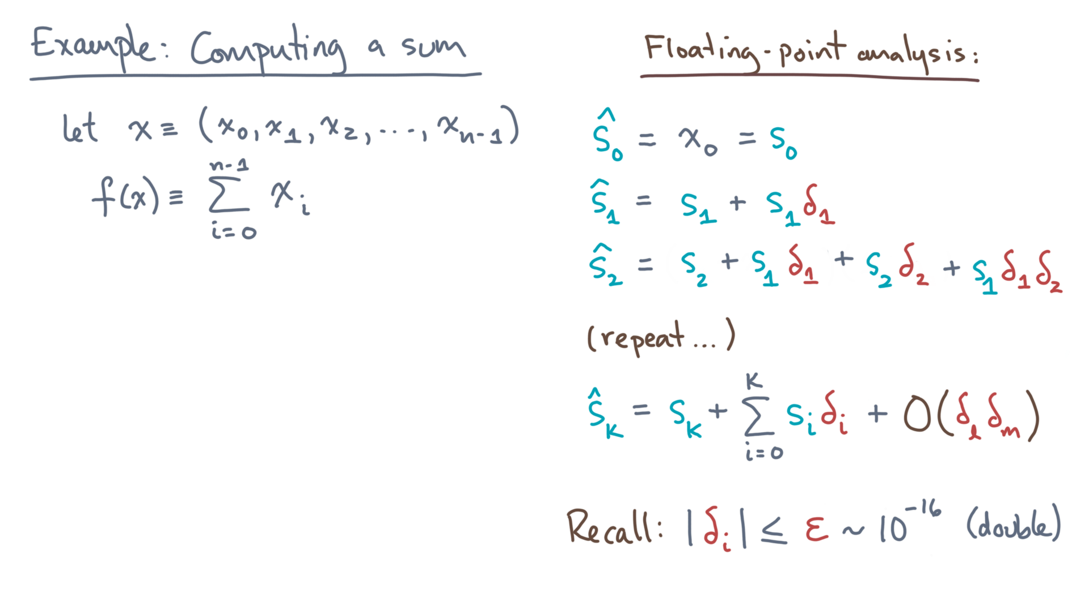
def alg_sum(x):
s = 0.0
for x_i in x:
s += x_i
return s
Notes:
In IEEE double-precision, that’s about 10-to-the-minus-16, which is pretty small.

Slide 50
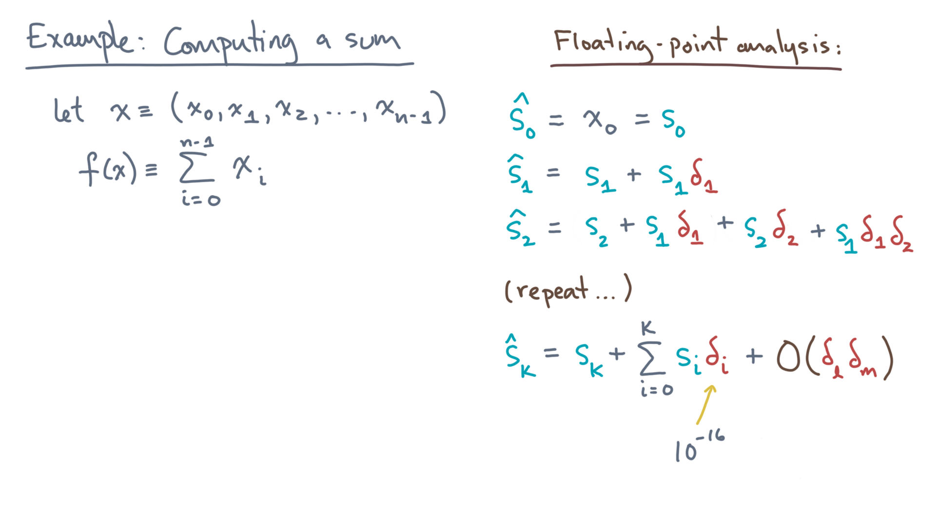
def alg_sum(x):
s = 0.0
for x_i in x:
s += x_i
return s
Notes:
Now think about the *products* of these deltas.

Slide 51
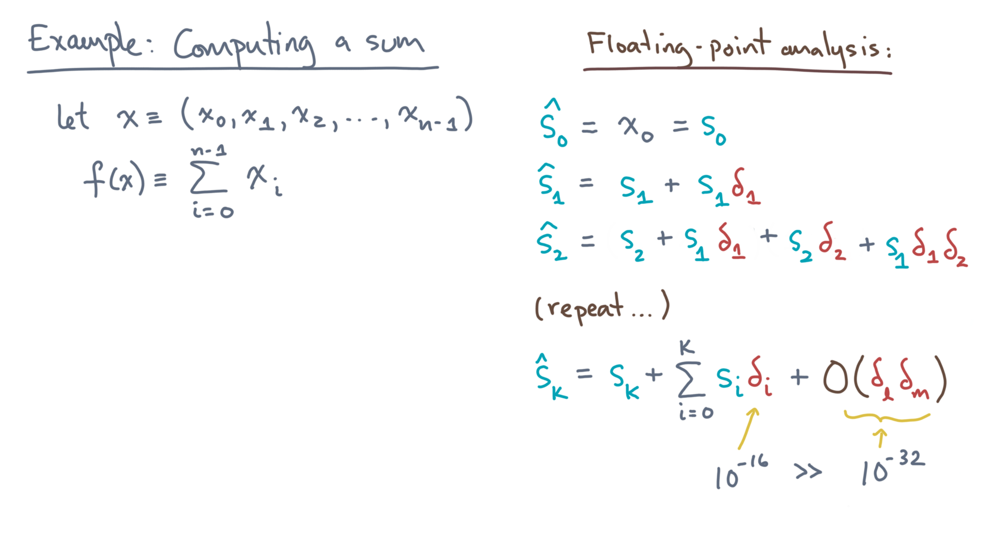
def alg_sum(x):
s = 0.0
for x_i in x:
s += x_i
return s
Notes:
The second order terms will be roughly 10-to-the-minus-32, which is much smaller than even 10-to-the-minus-16.

Slide 52
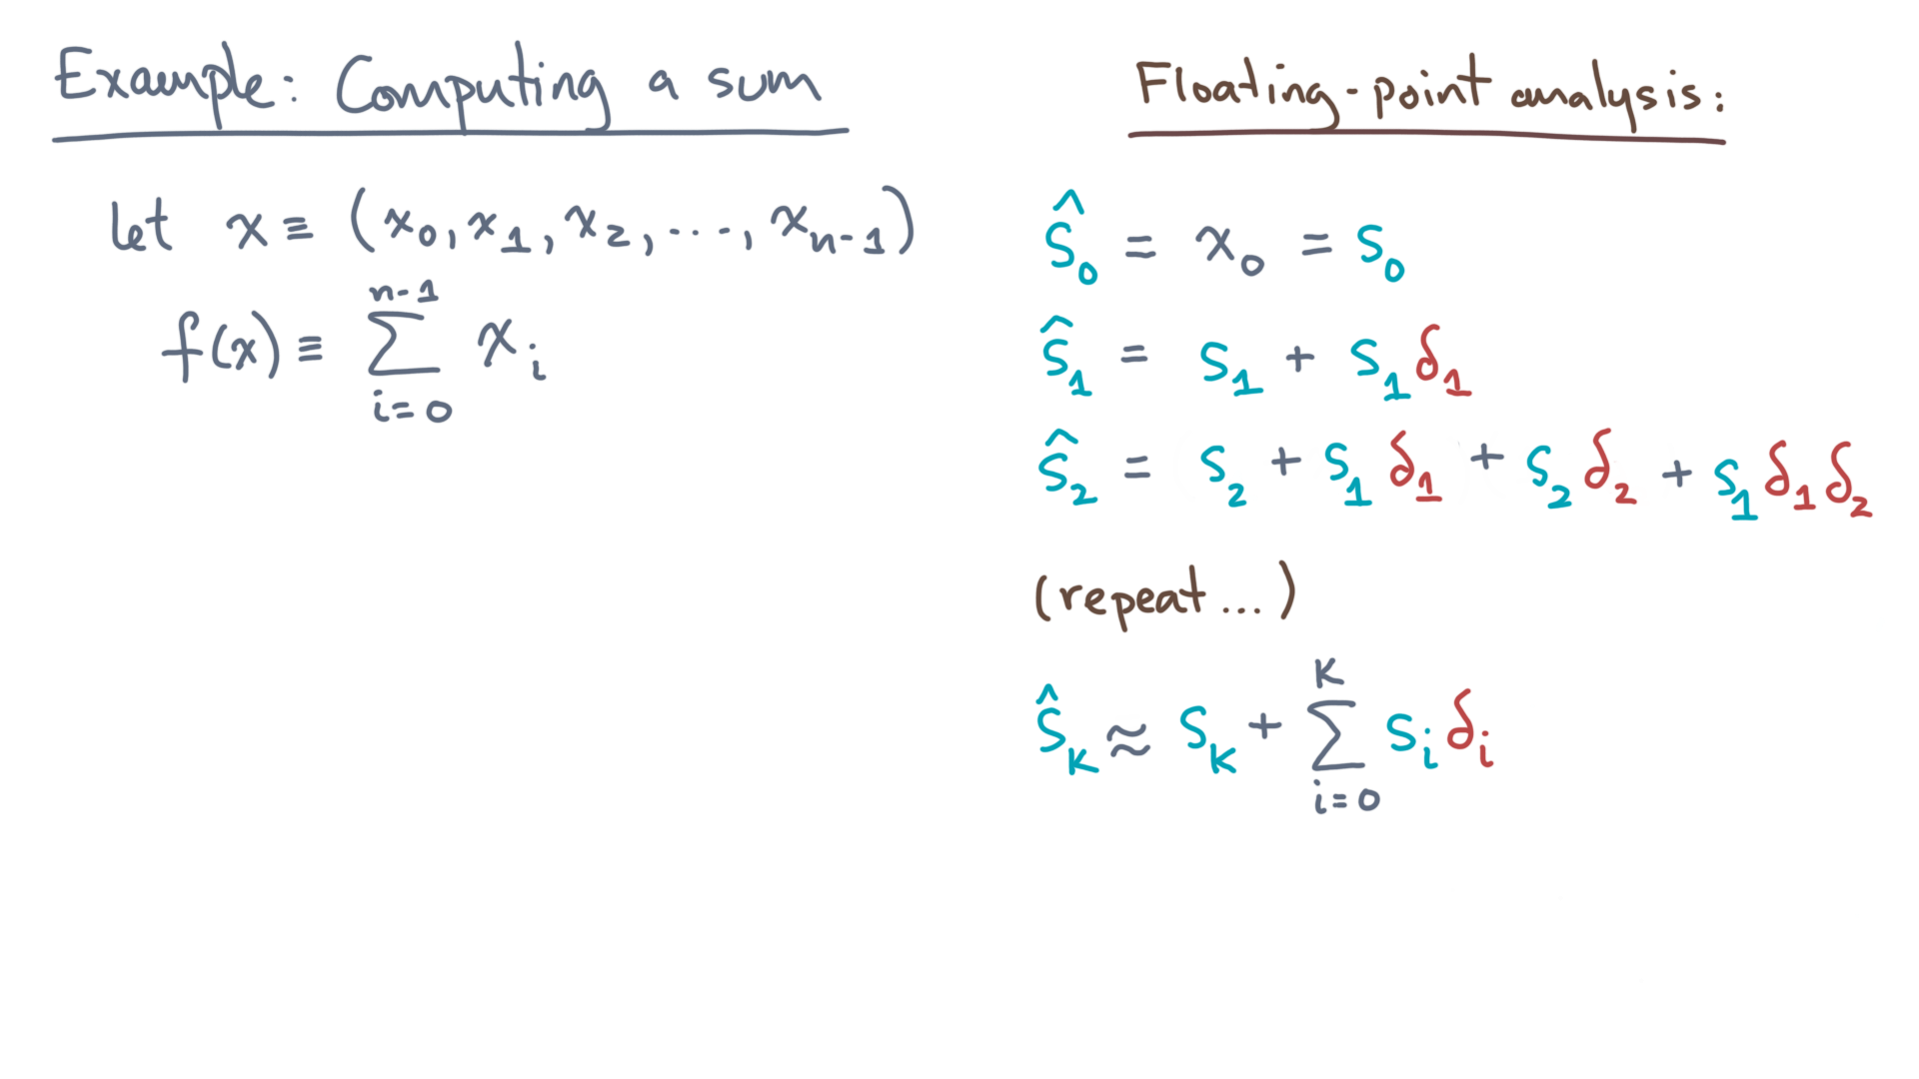
def alg_sum(x):
s = 0.0
for x_i in x:
s += x_i
return s
Notes:
Therefore, let’s drop it like it’s hot, leaving us with this.
The computed value of “s” after some number of iterations is the *exact* value plus the sum of first-order errors.

Slide 53
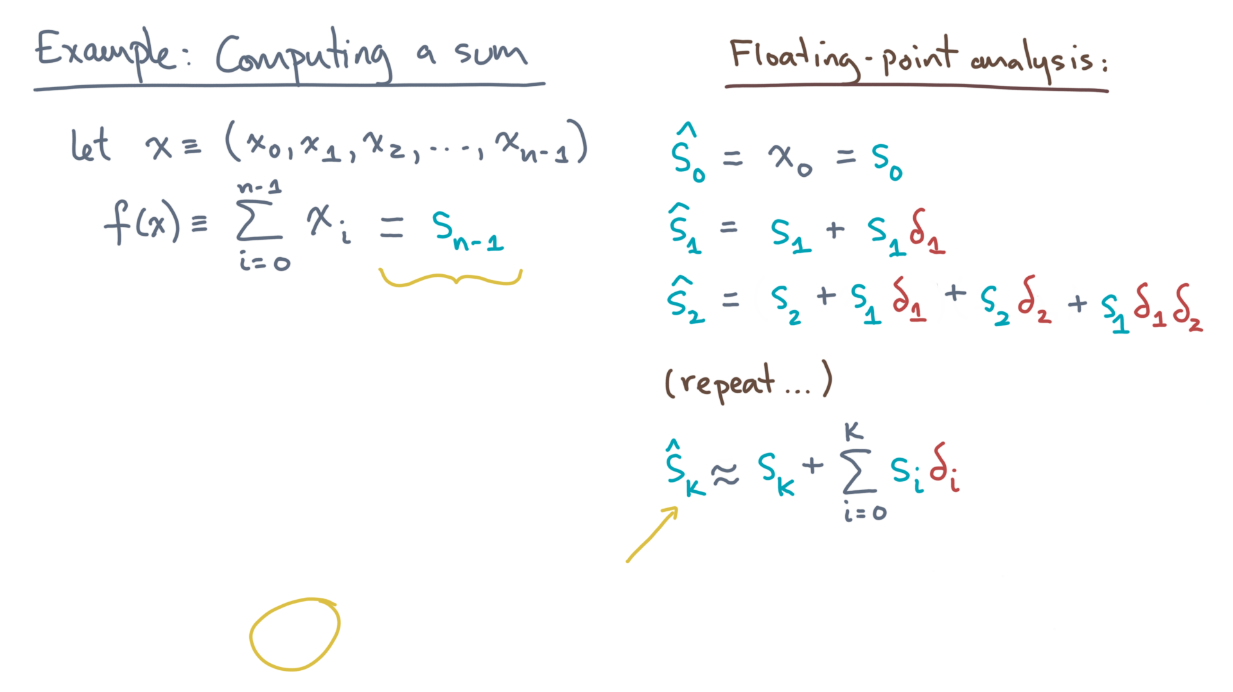
def alg_sum(x):
s = 0.0
for x_i in x:
s += x_i
return s
Notes:
Now what we want is the final value.
That’s the same as k equals n-1.

Slide 54
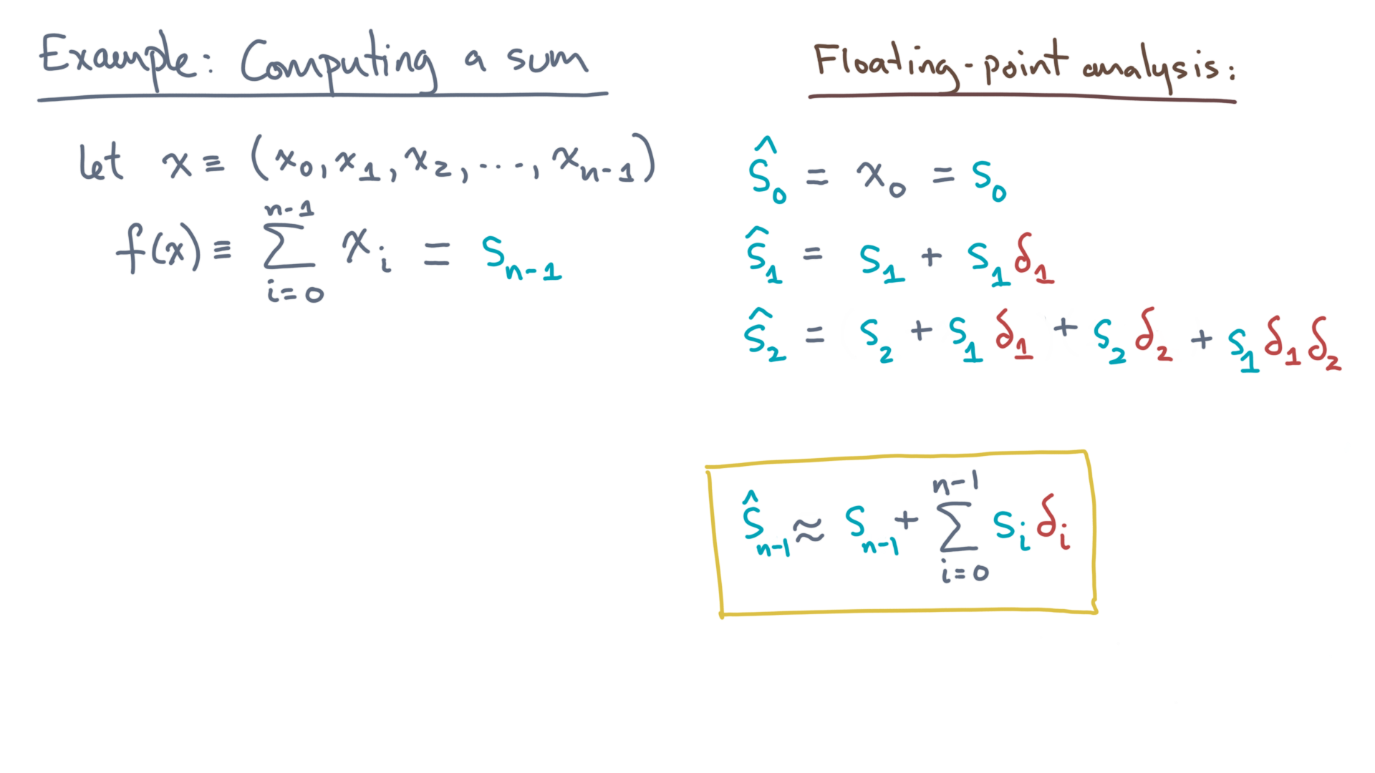
def alg_sum(x):
s = 0.0
for x_i in x:
s += x_i
return s
Notes:
Voila!
Unfortunately, we’re not quite done.
The next question, what do we do with this result?

Slide 55
Notes:
To answer that, you’re going to need to take this basic result and see if you can do a forward or a backward error analysis using it.
So take a moment to look it over, and when you’re ready, move on to the next lesson.
There, we will apply this result to argue whether or under what conditions this program may be expected to produce a reasonably accurate answer.

